Slide 1
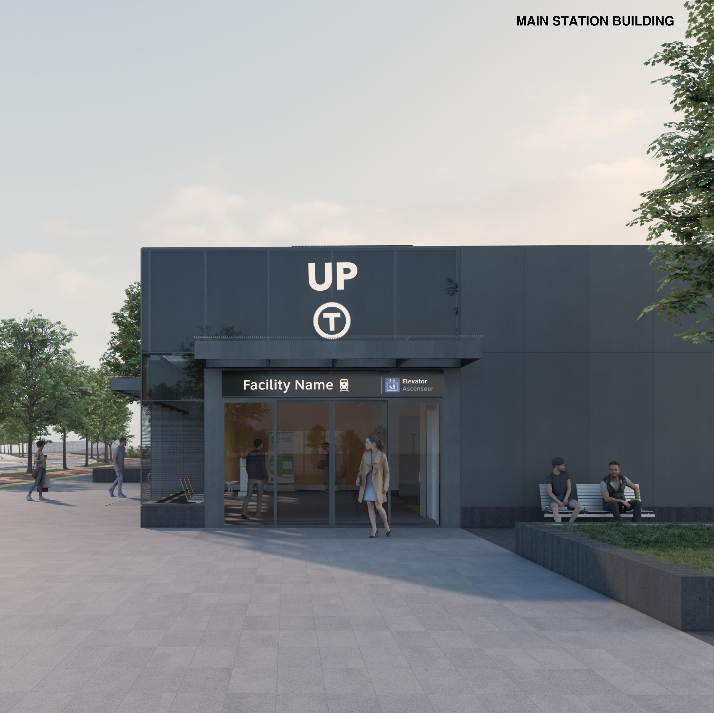
St. Clair-Old Weston Station
Construction Liaison Committee (CLC)
April 08, 2026
Cet présentation est disponible en français sur demande.
Si vous êtes intéressé, veuillez envoyer un courriel à TorontoWest@metrolinx.com
Rendering of the future St.Clair-Old Weston station. Subject to change.
Notes:
Introductions
Mention we can transcribe but not record (if asked).

Slide 2
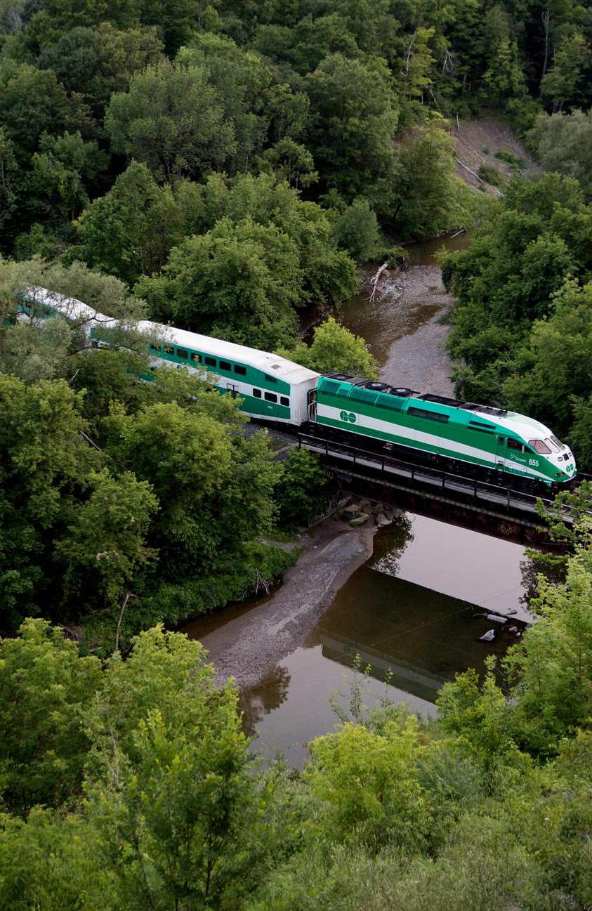
LAND ACKNOWLEDGEMENT
Metrolinx acknowledges that we connect communities by building and operating transit within the traditional lands of the Anishinaabe, the Haudenosaunee and the Wendat peoples, for whom these lands continue to have great importance.
Treaties between First Nations and governments cover these lands, and the promises contained in these Treaties remain relevant to this day.
Metrolinx and its employees are committed to understanding the history of these lands and the continued impacts of colonization and take responsibility for actions to advance reconciliation.
Metrolinx will continue to seek the knowledge, expertise and experience of Indigenous partners and commits to doing business in a manner that is built on a foundation of trust, respect, and collaboration.

Slide 3
Safety Moment

Slide 4
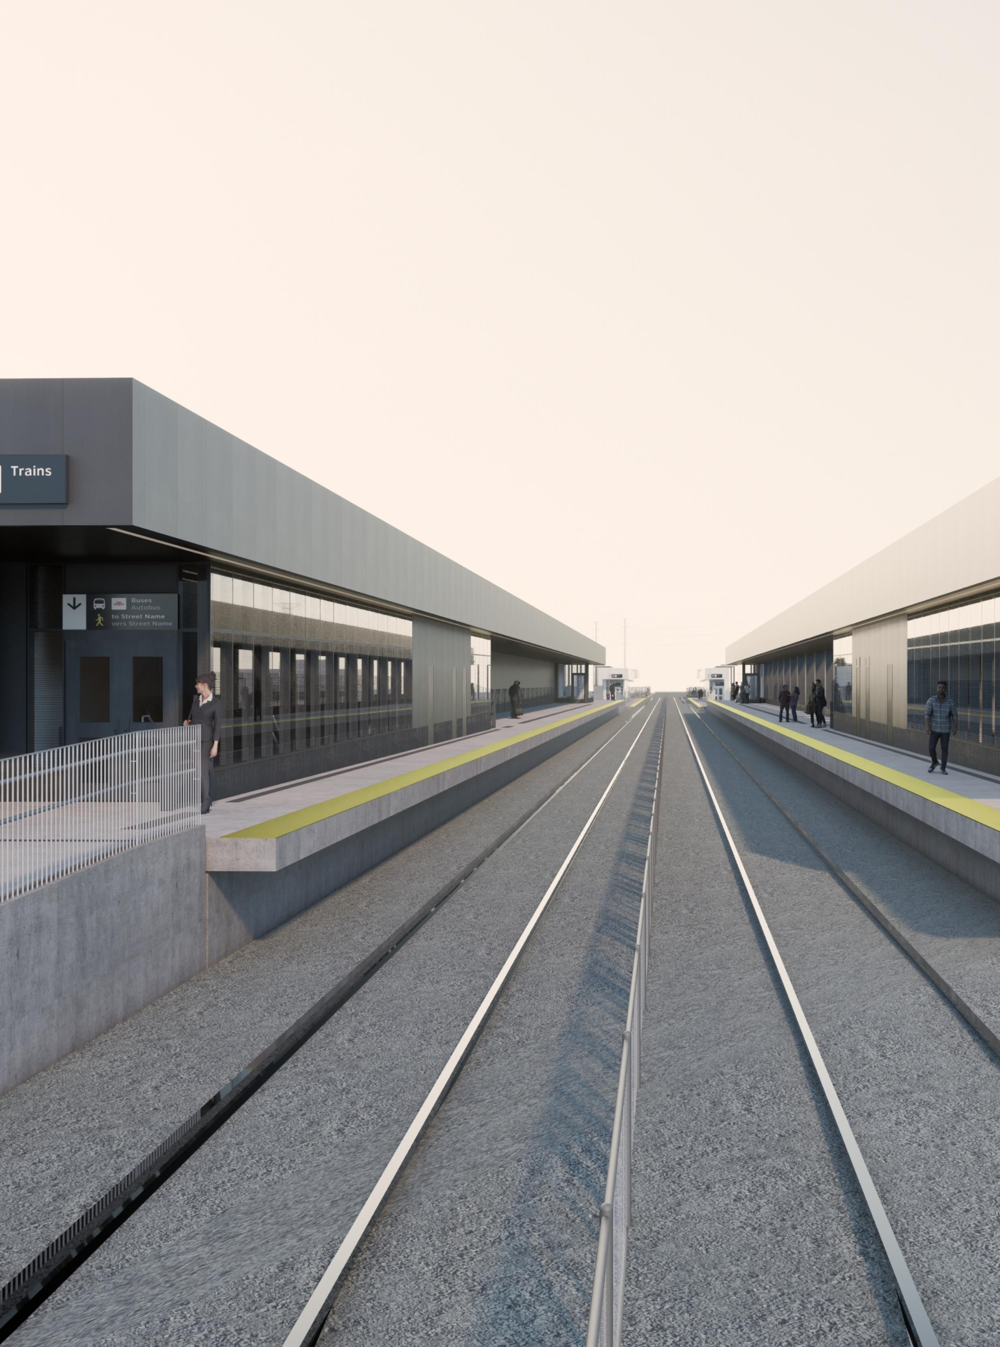
Agenda
Welcome
Project Overview
Construction Updates
Discussion
Contact us
Rendering of the South Platform at the future St.Clair-Old Weston station. Subject to change.

Slide 5
St. Clair-Old Weston Station: Project Overview

Slide 6
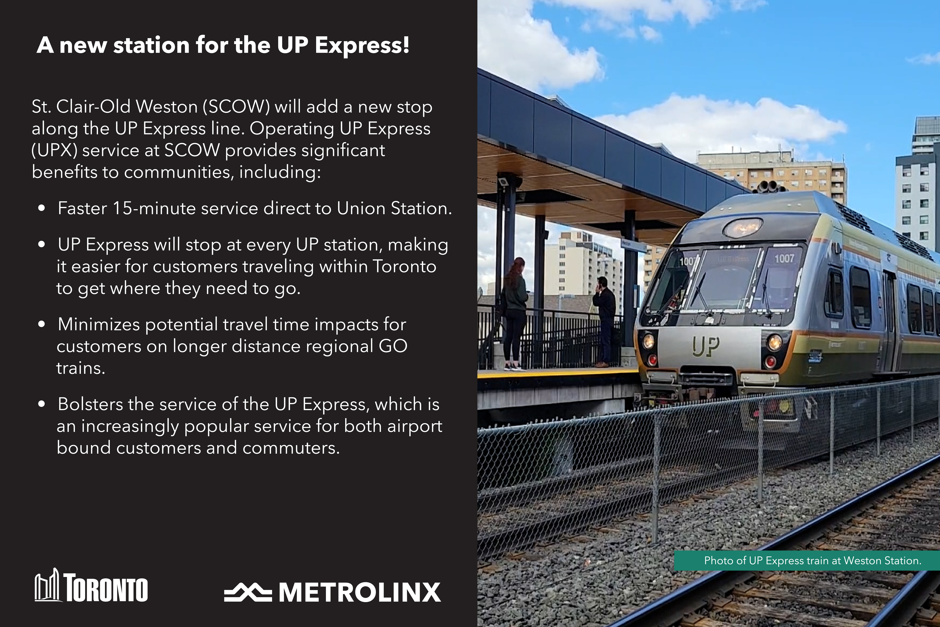
Notes:
S. Clair-Old Weston will add a new stop along the UP Express line and will provide a number of benefits to nearby communities, including faster and direct 15-minute service to Union Station.

Slide 7
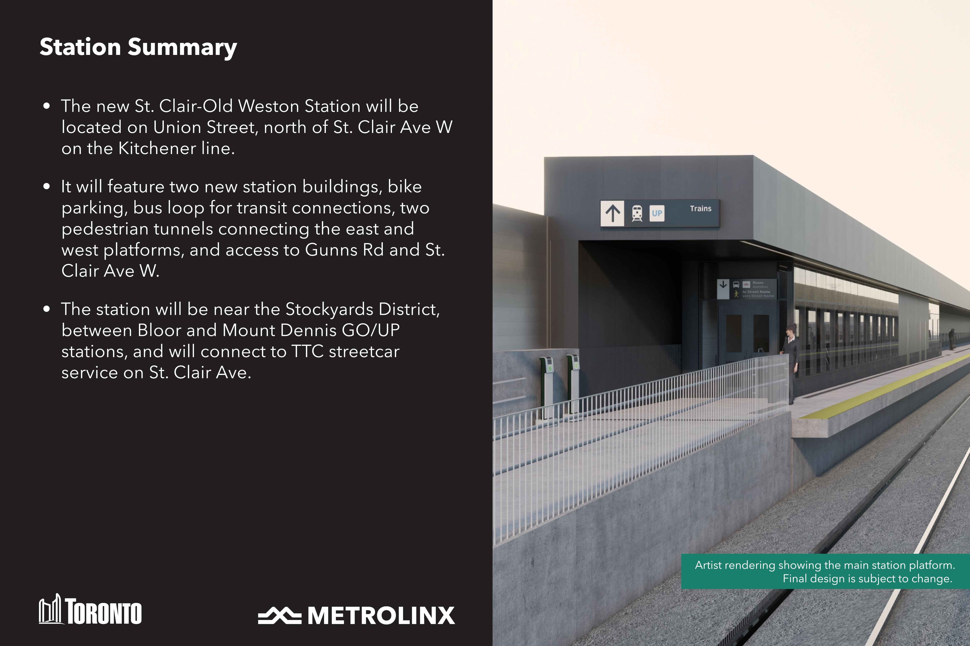
Notes:
The station will will feature bike parking, a bus loop, two pedestrian tunnels, and two station buildings. It will also connect to TTC streetcar service on St. Clair Avenue, and provide access to Gunns Road and St. Clair Avenue West.

Slide 8
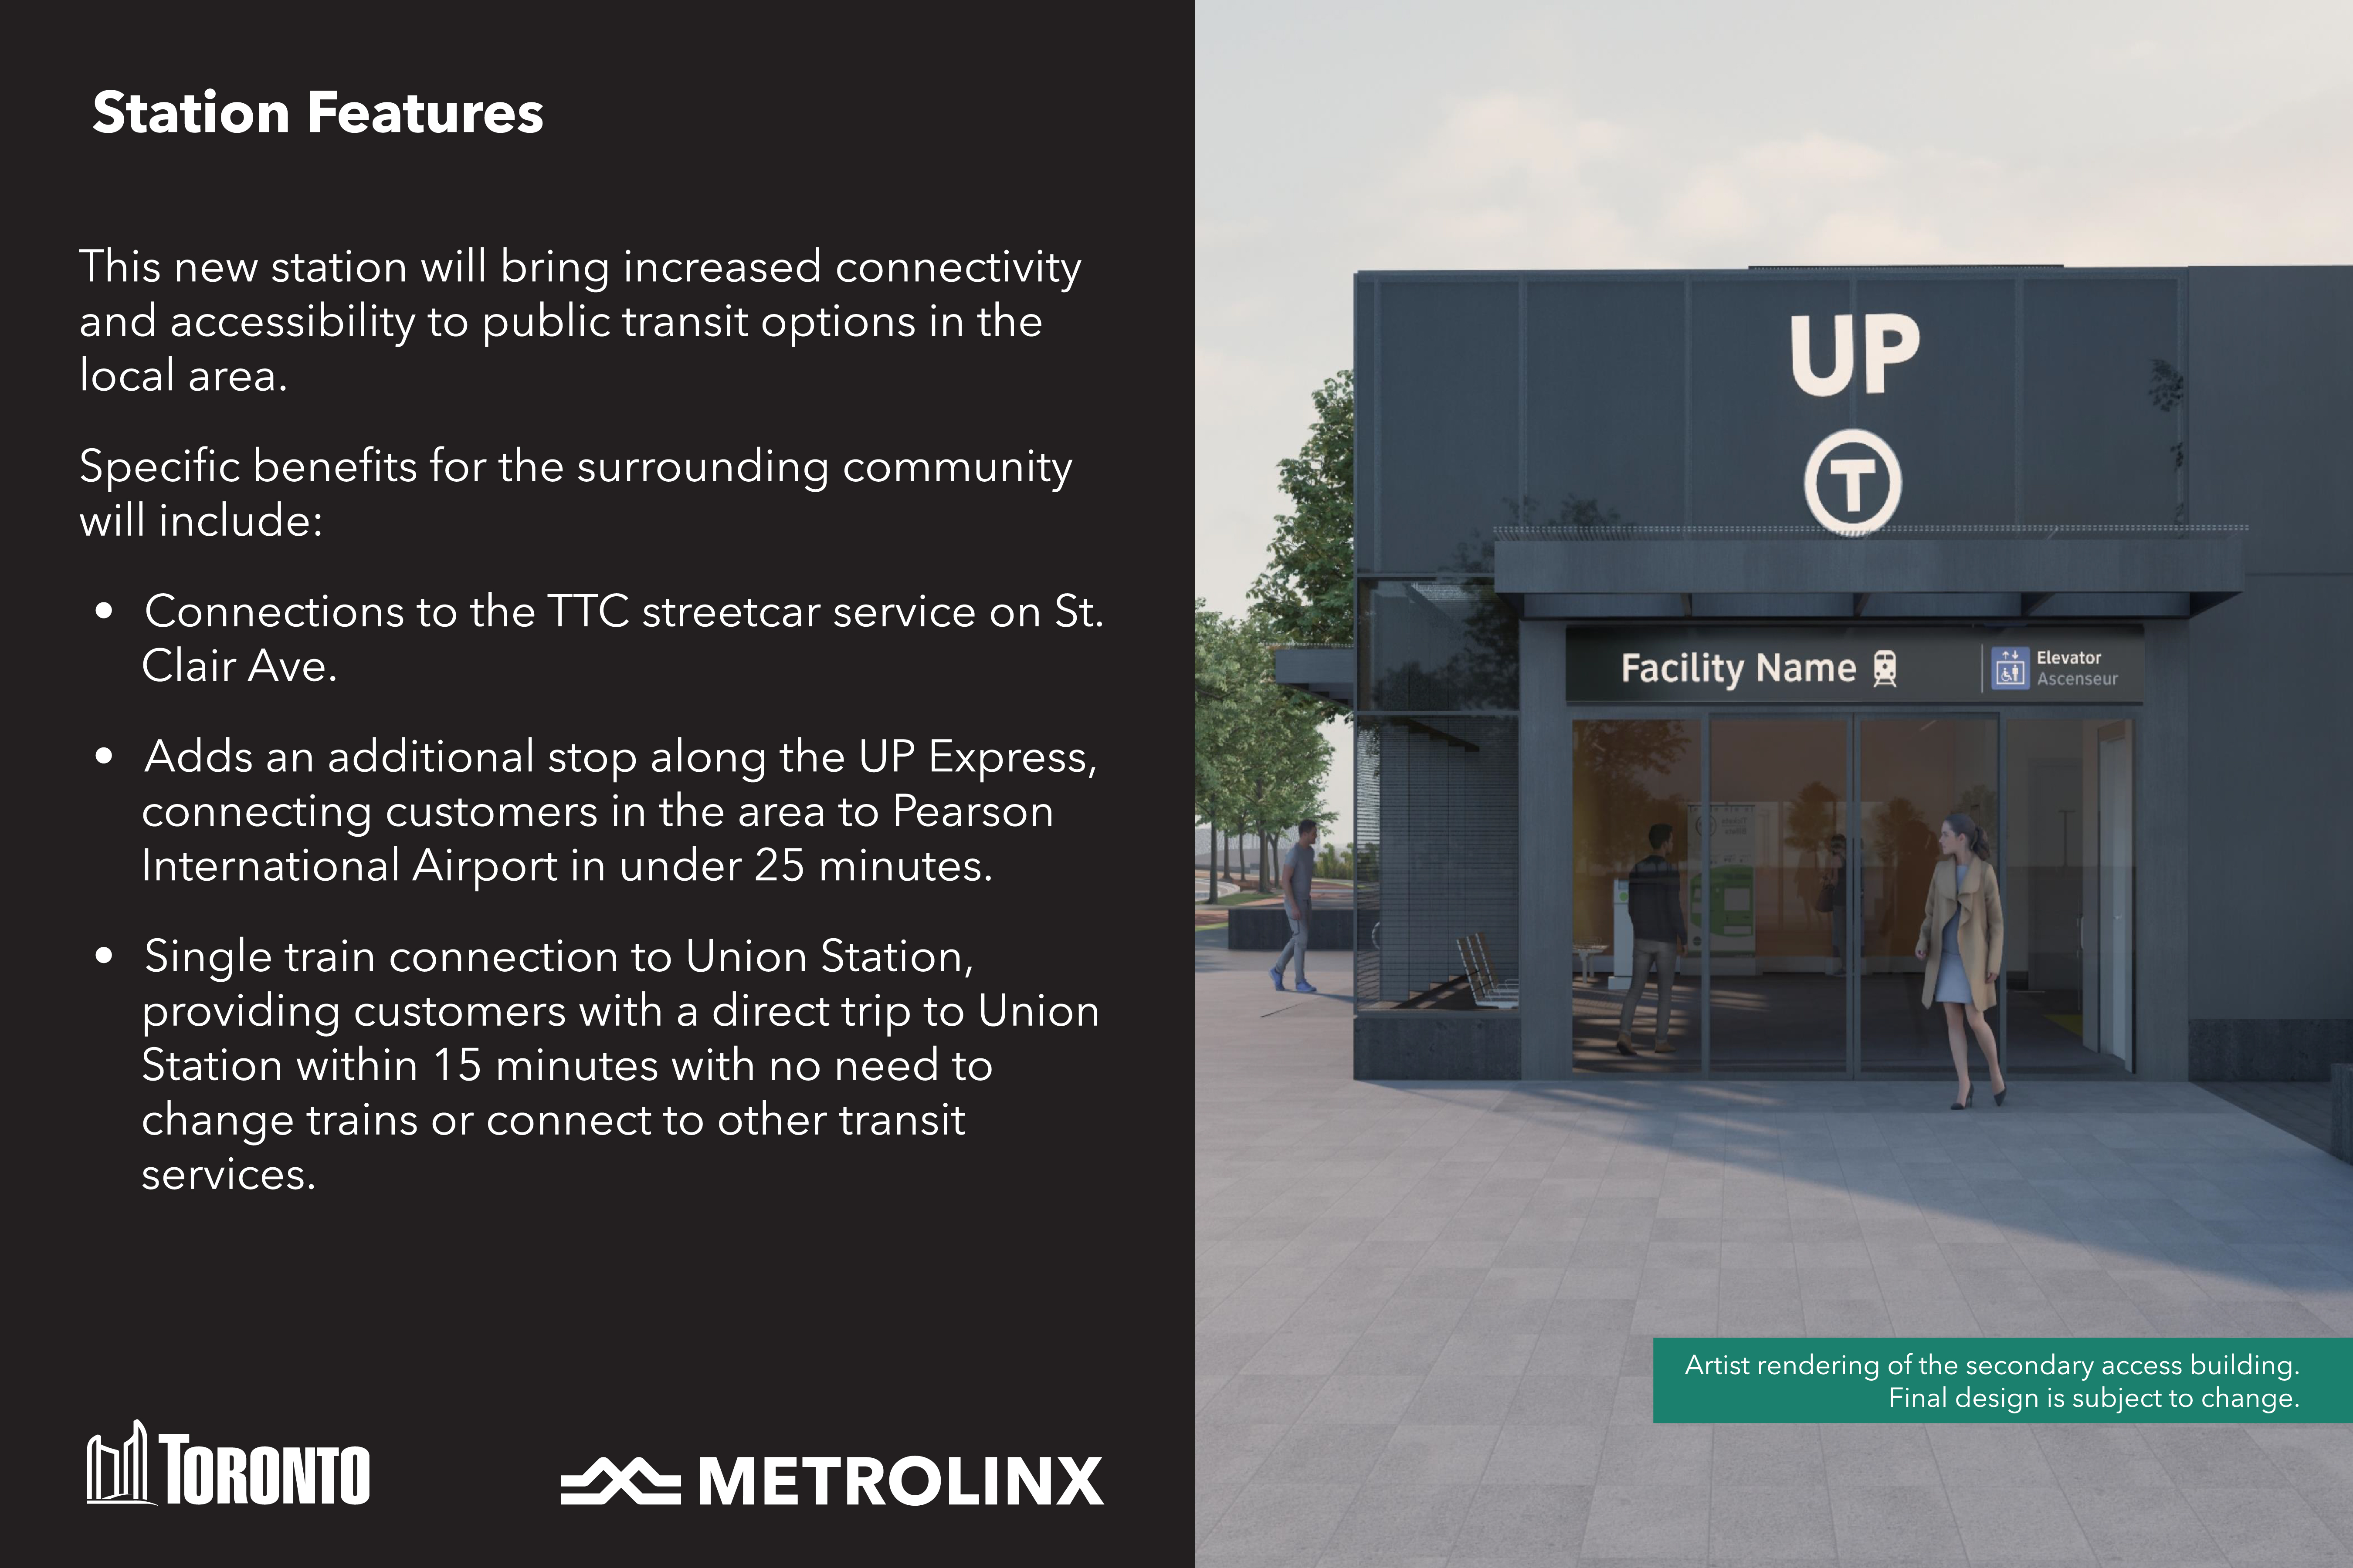
Notes:
Additional features include providing residents in the area with a connection to Toronto’s Pearson International Airport in under 25 minutes.

Slide 9
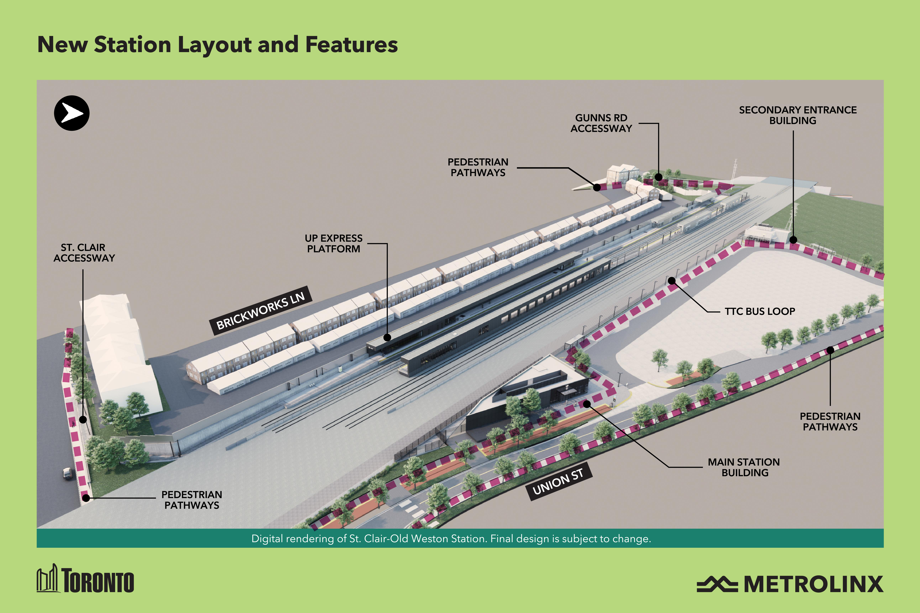
Notes:
Here, you can see some of the station layout and features visualized. Please note that final design is subject to change.

Slide 10
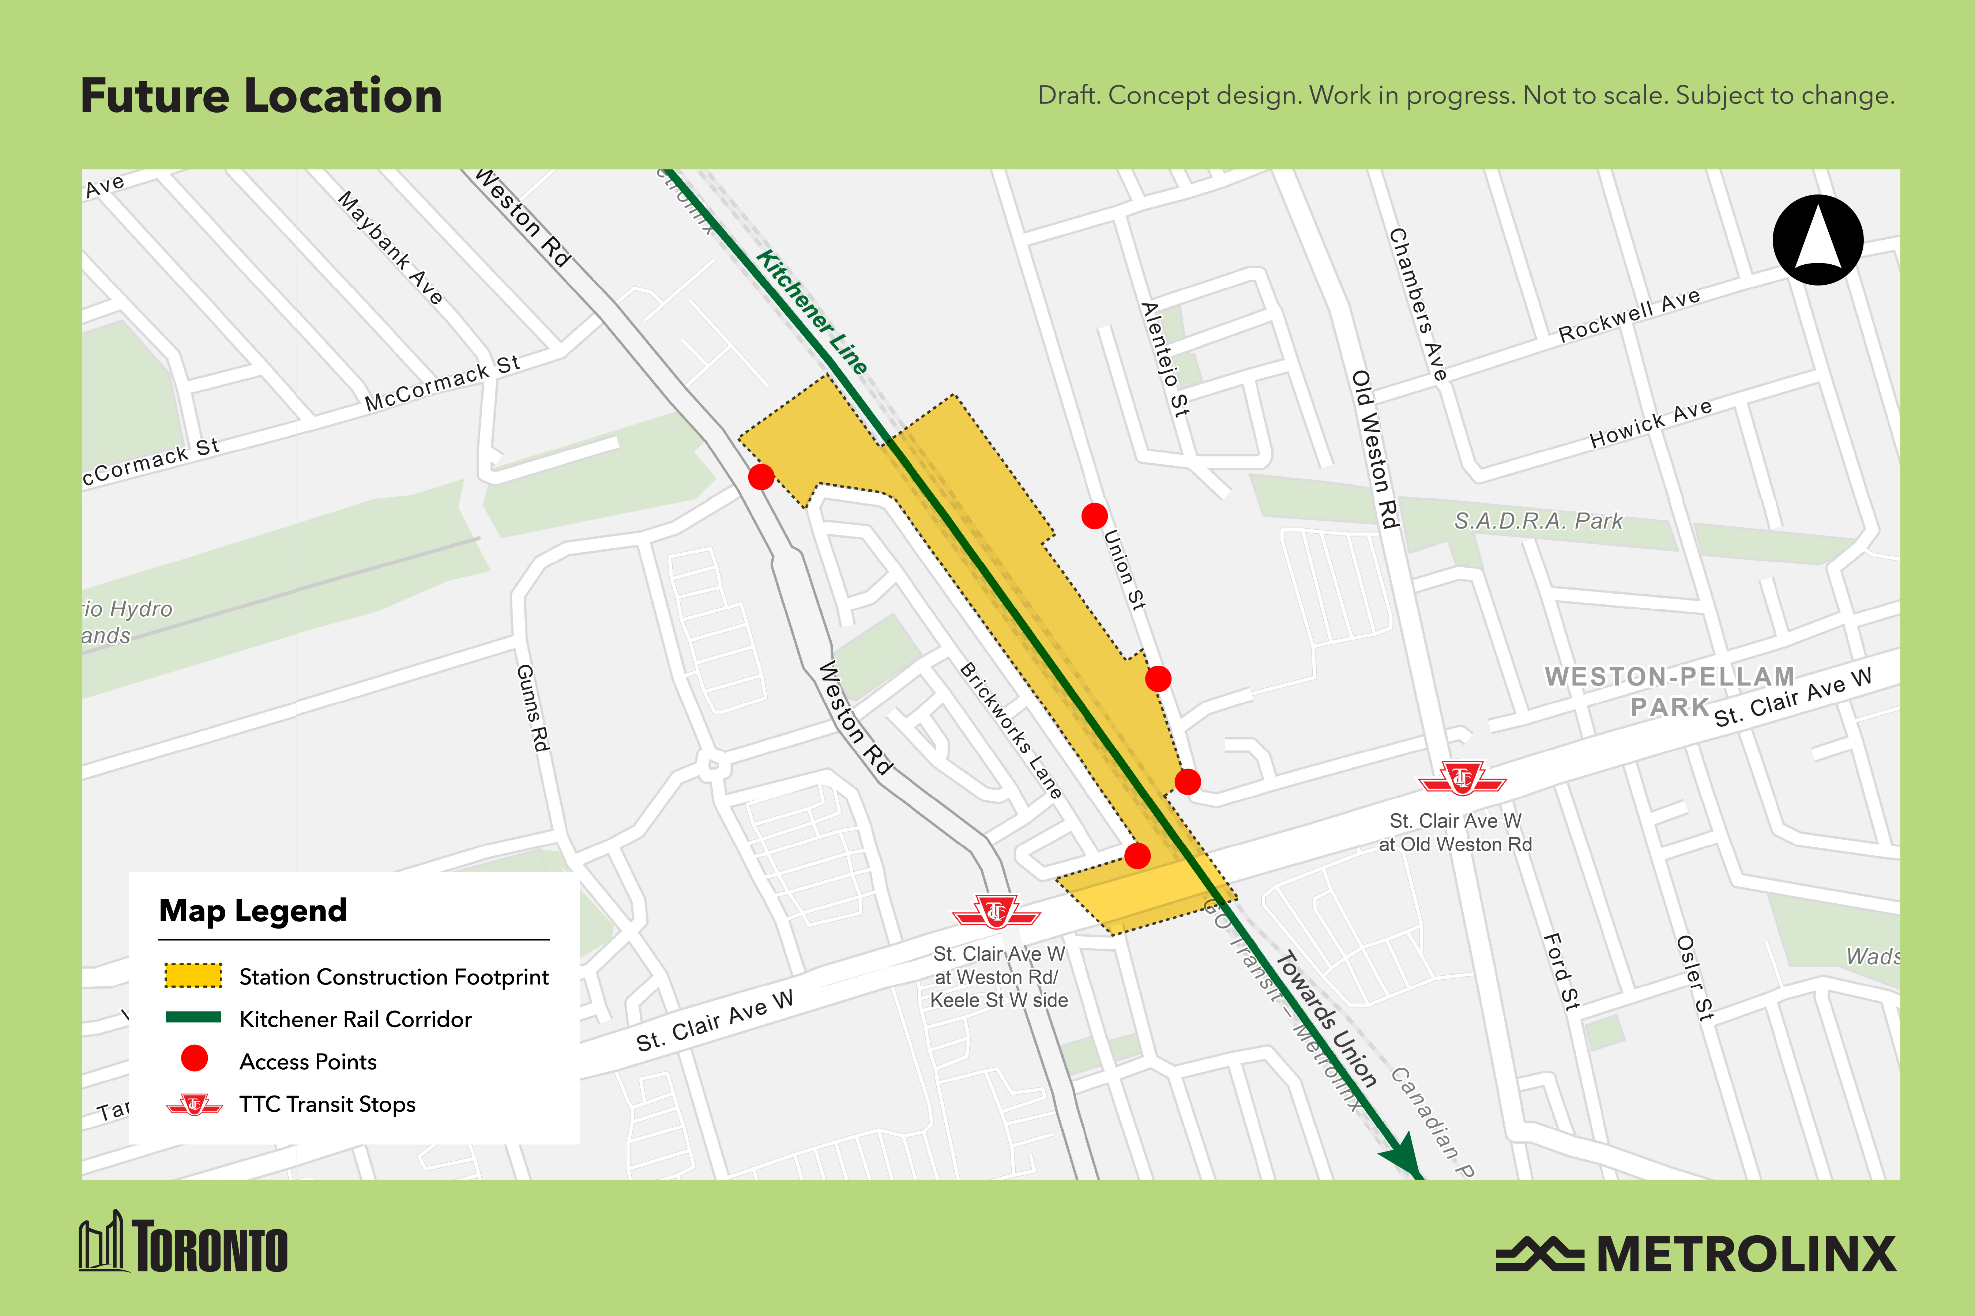
Notes:
The station will be location along the Kitchener line at Union Street, north of St. Clair Avenue West.

Slide 11
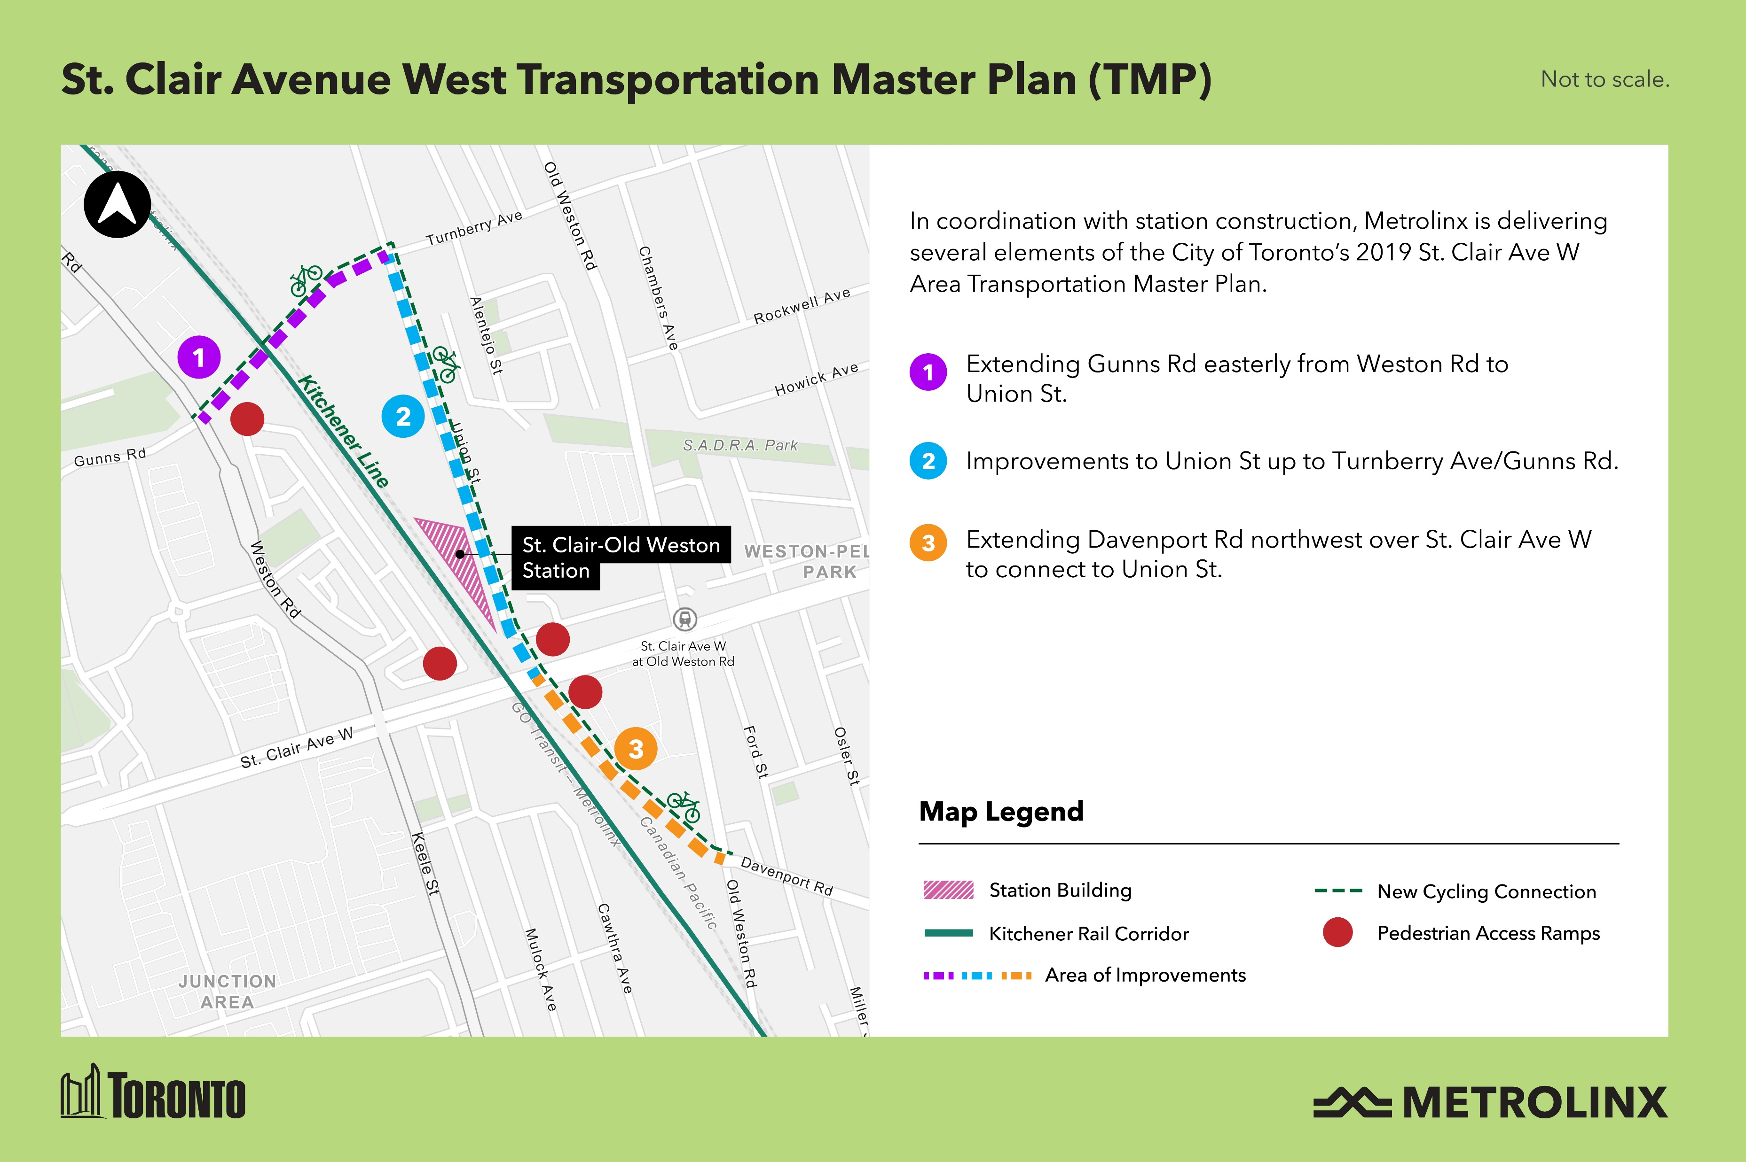
Notes:
In partnership with the City of Toronto, Metrolinx will be delivering several enhancements as part of the St. Clair Ave West. Transportation Master Plan, such as an extension of Gunns Road, improvements to Union Street, and an extension of Davenport Road.

Slide 12
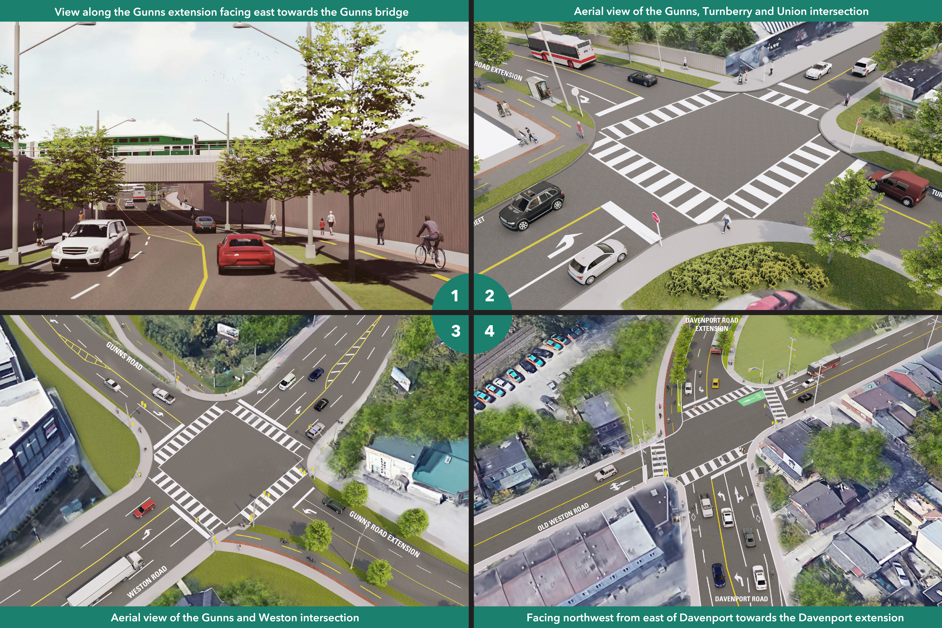
Notes:
Here you can see some of the enhancements visualized. Please note that these images are conceptual.

Slide 13
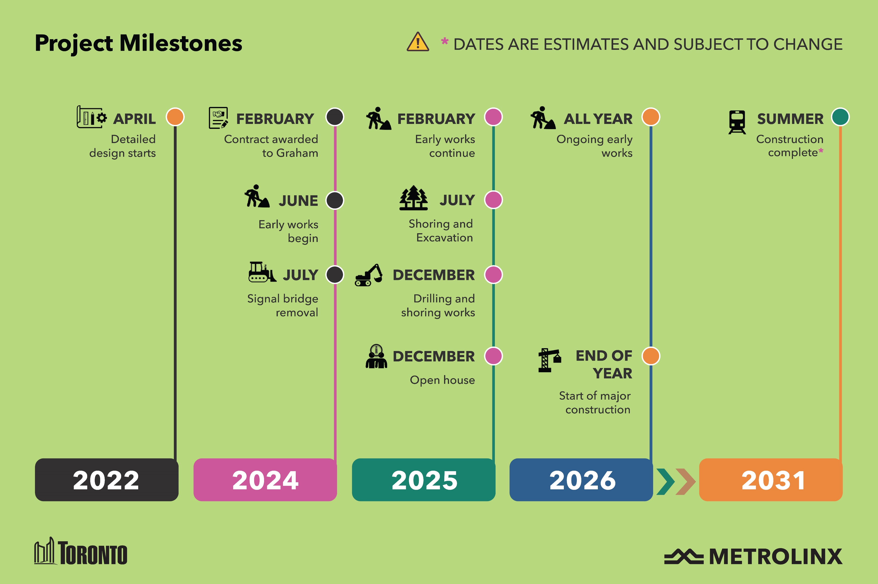
Notes:
Here, we can see an overall timeline of this project so far. Detailed design began back in 2022, with the contract being awarded and Early Works starting in 2024. Please note that all future dates are estimates.

Slide 14
Construction Updates

Slide 15
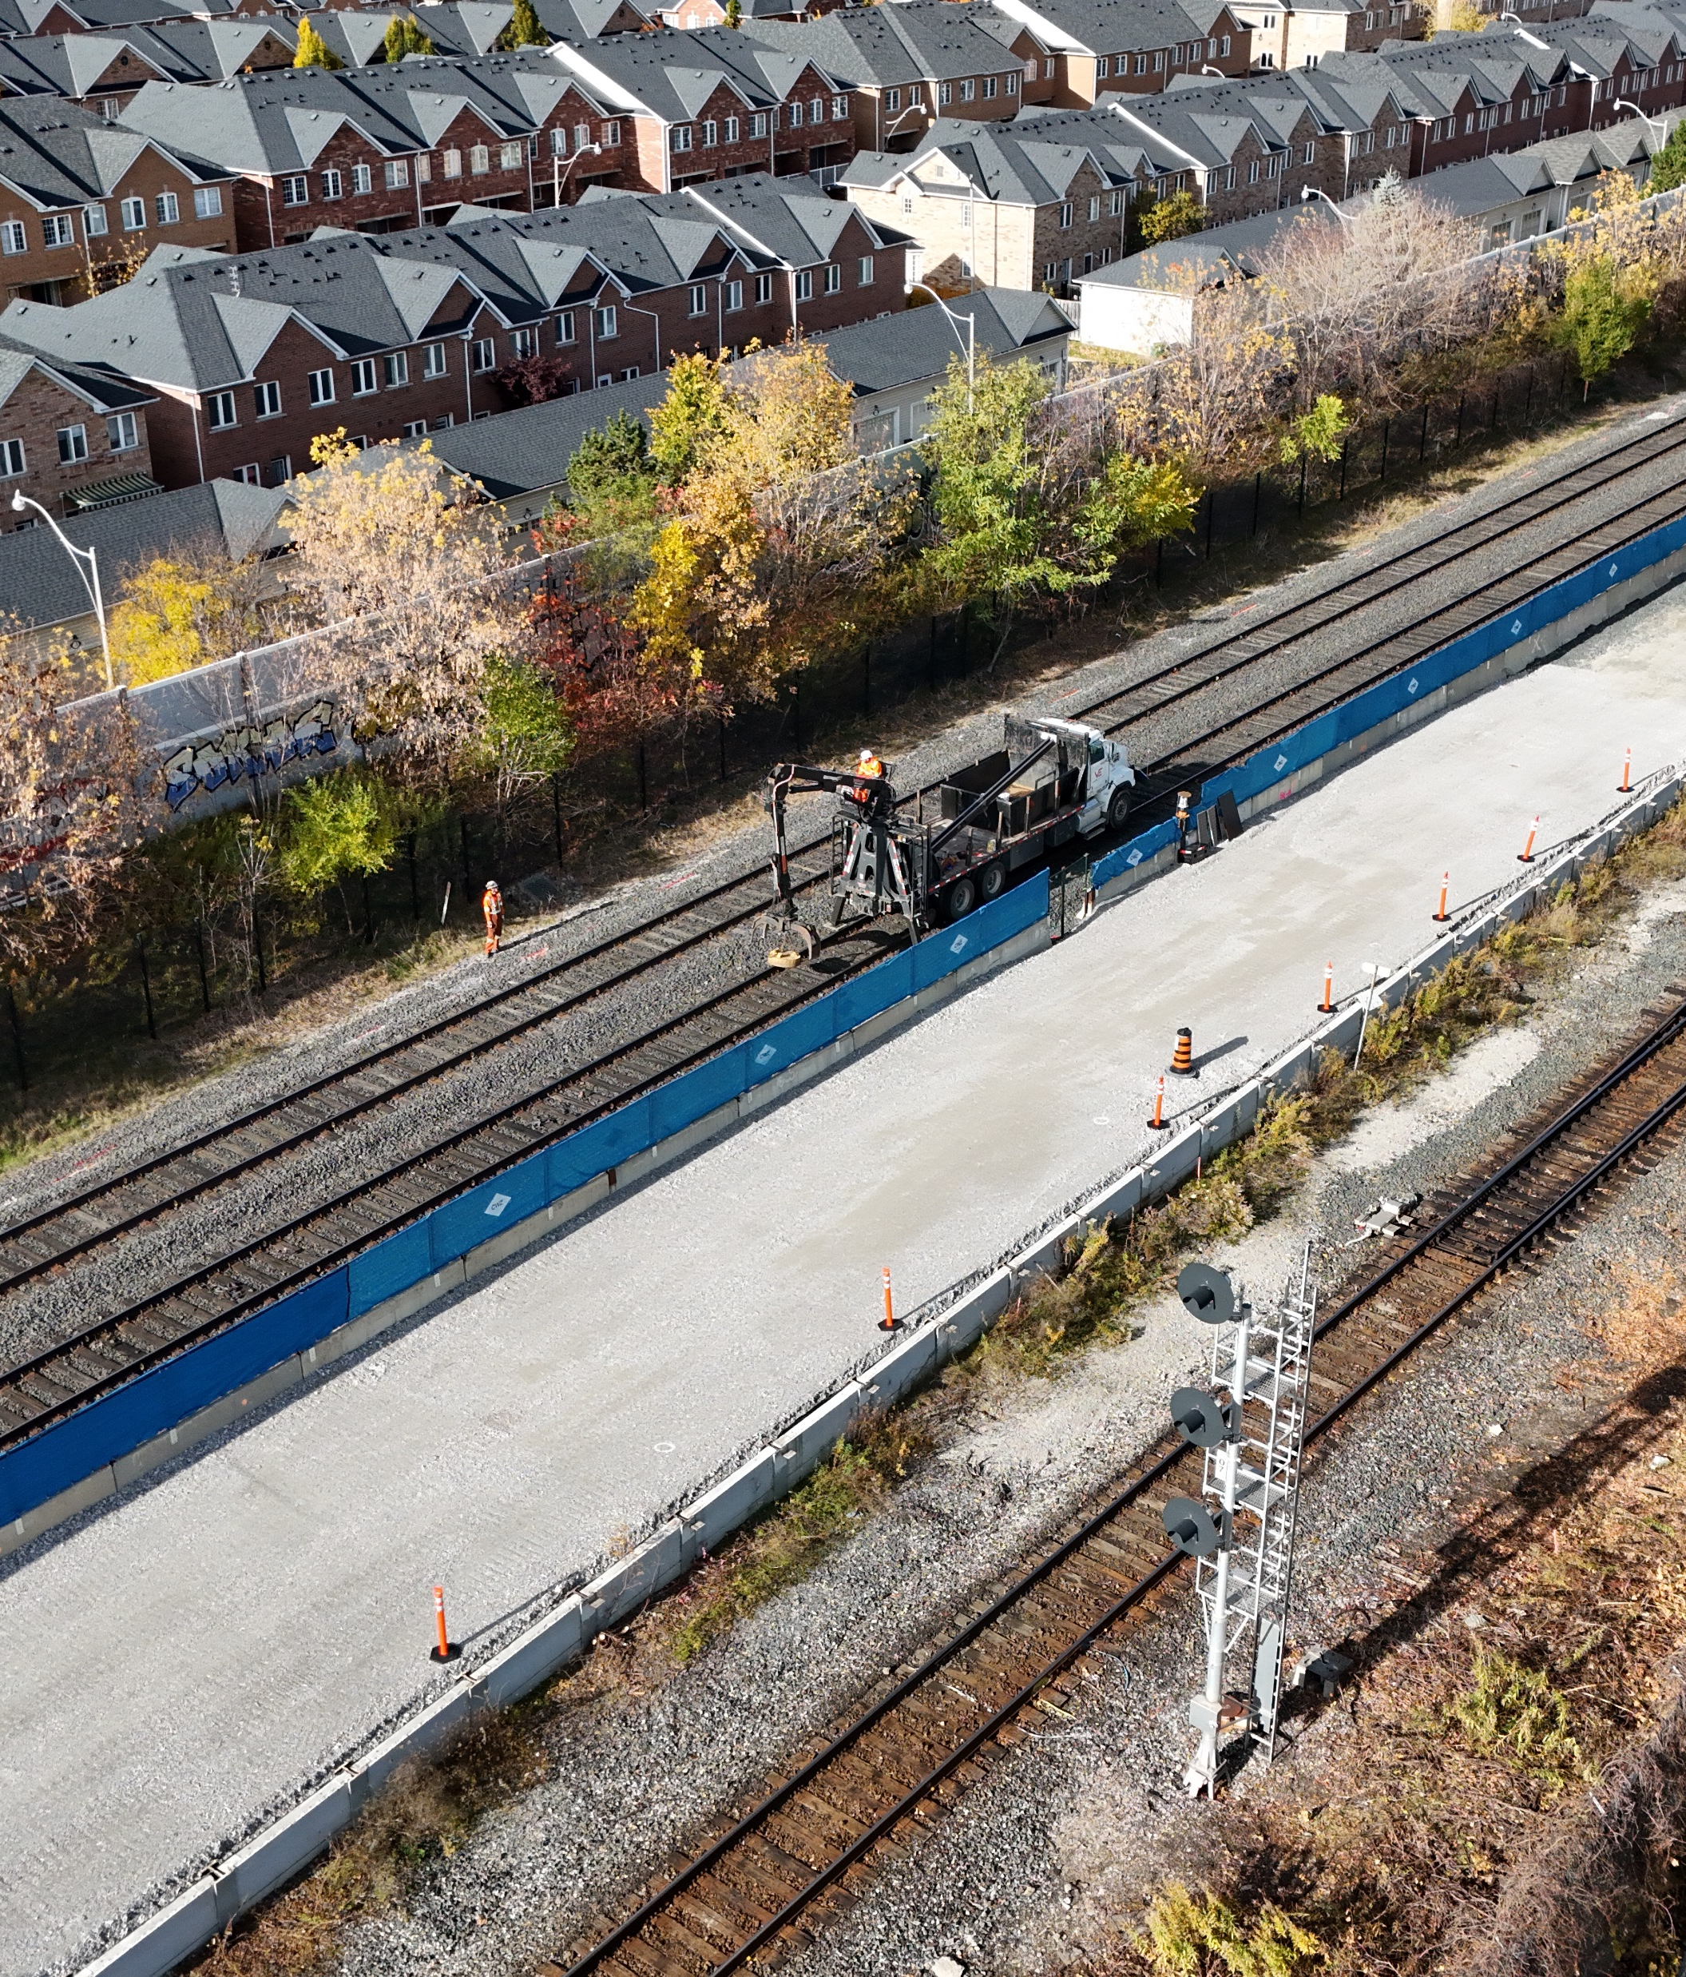
Works Completed
September 2025
Demolition of retaining wall within corridor to enable track work.
December 2025
Support of Excavation (SOE) drilling work at St. Clair Bridge, impaired and removed existing T1 Track.
December 2025
Demolition of 153 Weston (ABC Lumber) upper structure
January - March 2026
Track construction works including installation of SOE at north and south tunnels.
March 27-29, 2026
Major Track Closure, various activities including CPKC to T1 diversion and relocation of works carried out during this window.
June - September 2025
Continuous Work Zone (CWZ ) established for first stage of work
Continuous Work Zone established at the site of the future station.

Slide 16
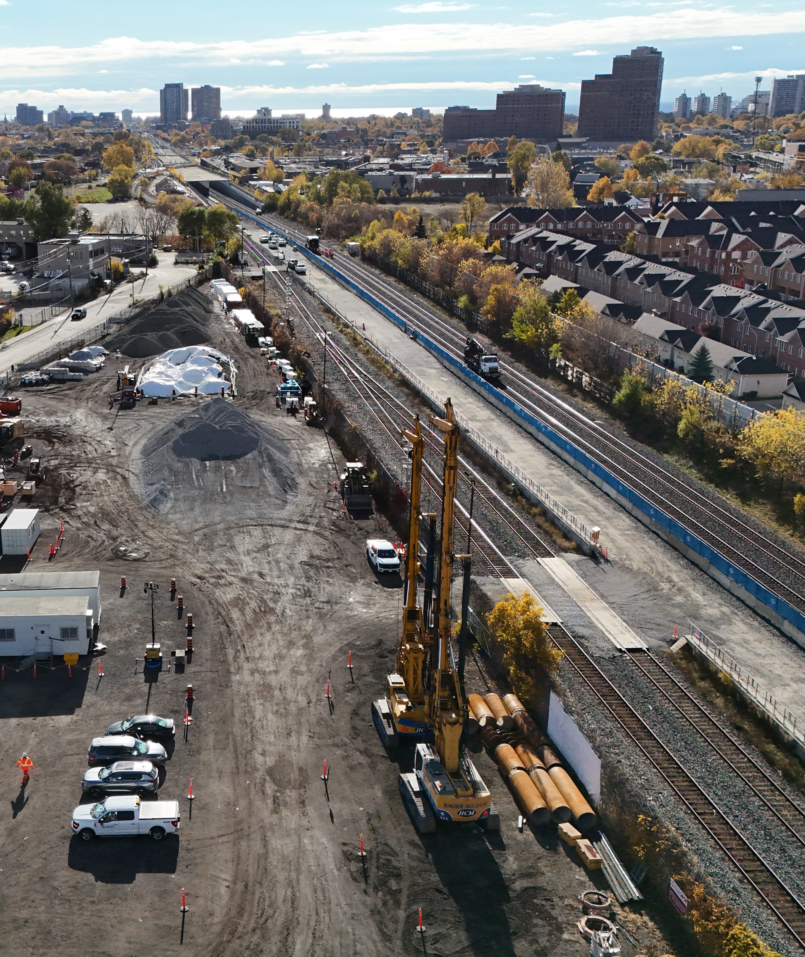
Completed/Ongoing Works
Expansion of CWZ for second stage of works.
May – June 2026
January – April 2026
Continuation of track construction and CWZ for Stage 2 works.
Divert CPKC rail from mainline to T1 diversion track.
Preparation works for Stage 2 construction.
May 1-3, 2026
March – May 2026
January – March 2026
Drill rig pad removal and clearing and grubbing.
Site of the future station featuring the expanded Continuous Work Zone.

Slide 17
Construction Lookahead
Timeline* *dates are tentative | Activity | Description | Hours
April 17 – 20, 2026 | Major Track Closure (MTC) | Track diversion and establishment of Continuous Work Zone (CWZ) for Stage 2 | Continuous day and night work from Friday evening to Monday morning
May 1-3, 2026 | Canadian Pacific-Kansas City (CPKC) Track Diversion Works | Track diversion rebuild by CP Rail. | Daytime 7:00 a.m.-5:00 p.m.
May 15-19, 2026 | Major Track Closure (MTC) | CPKC-T1 Track diversion and cutovers, establishment of Continuous Work Zone (CWZ) for Stage 2 works. | Continuous day and night work from Friday evening to Tuesday morning
*Environmental assessment works will be ongoing which includes geotechnical investigations such as borehole drilling and soil sampling.

Slide 18
Environmental Monitoring
Notes:
Flag that data is backdated as the results take time to compile and assess.

Slide 19
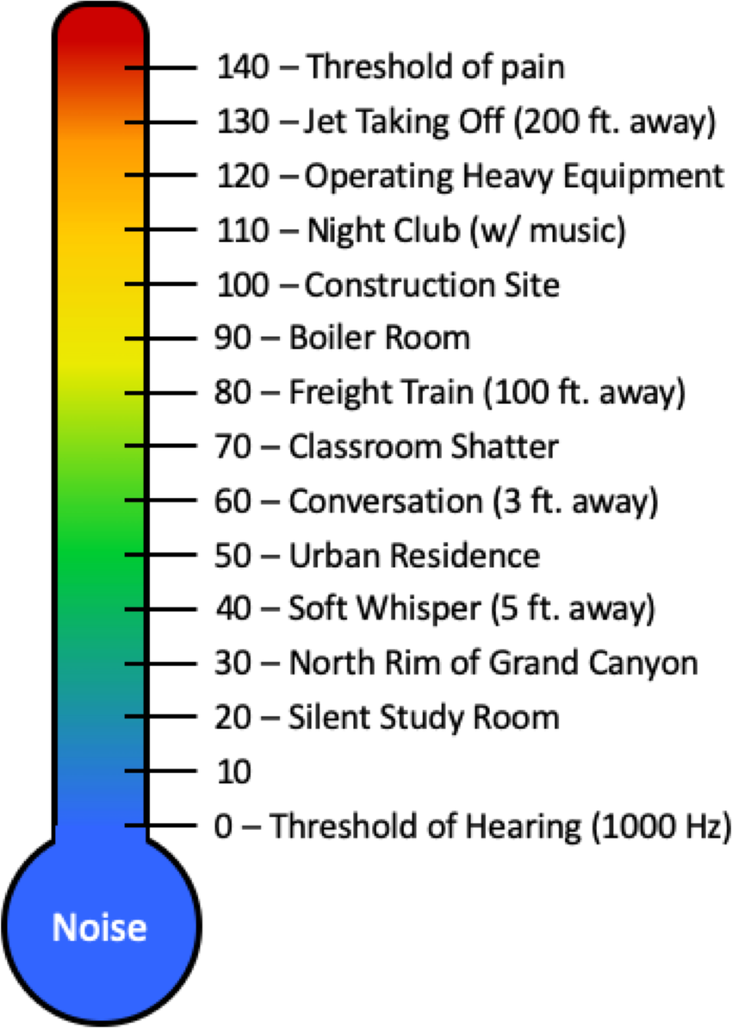
Important Context for Interpreting Noise Monitoring Data
What is Leq 15 min?
A 15-minute average of all sound during that period
Loud and quiet moments are blended together
One loud event (train horn, truck, machinery) can raise the entire average
What an “exceedance” means
The measured level was above the applicable guideline
It does not always mean construction caused it
It includes all sound at the monitor (traffic, trains, voices, weather)
Classroom Chatter
What the monitor captures
A fixed outdoor microphone recording all ambient noise
Cannot distinguish project vs. non-project sources
Weather, rail traffic, and nearby activity can influence readings
How exceedances are used
Teams review each exceedance to identify causes
Helps improve mitigation, scheduling, and community notifications
Supports transparency and continuous noise management
Occupational Safety and Health Administration. OSHA Technical Manual (OTM) – Section III: Chapter 5 – “Noise”. U.S. Dept. of Labor, updated July 6 2022, “Figure 3. Decibel Scale”, www.osha.gov/otm/section-3-health-hazards/chapter-5#decibles. Accessed November 25, 2025

Slide 20
Noise Monitoring Summary for October to December 2025
Definition: Leq 15 min
Leq 15 min stands for “15-minute equivalent continuous sound level.” It is a standardized noise measurement that represents the average sound energy over a continuous 15-minute period, accounting for both loud and quiet moments. Even if noise fluctuates—traffic, trains, construction, voices—Leq smooths those variations into one representative value that reflects overall sound exposure for that timeframe.
Location of Monitor: 153 Weston Road - Construction Laydown Area
 | Number of days with
Month | Daytime exceedances: (7:01 – 19:00) | Evening exceedances: (19:01 – 23:00) | Overnight exceedances: (23:01 – 07:00) | # of days with active construction | # of complaints | Average Leq 15 mins (dBA) during Exceedances | Main Scheduled Activity
Oct 2025 | 4 | 0 | 0 | 22 | 1 | 85 | Excavation Ballast replacement Fence and piping installation Tree removal
Nov 2025 | 0 | 0 | 0 | 24 | 0 | N/A | Demolition of buildings Excavation Tree removal Grading and removal of soil stockpiles Ballast replacement
Dec 2025 | 0 | 0 | 0 | 15 | 0 | N/A | Backfilling Demolition of buildings Removal and replacement of ballast Grading and compaction Drilling Tree removal
*Number of days for daytime, evening, and overnight are not mutually exclusive
(e.g. if Oct 5 has exceedances at 14:00, 20:30, and 1:15, then Oct 5 is counted in all three categories
** Wind and rain occurrences have been omitted
*** Days where no work was scheduled have been omitted

Slide 21
Important Context for Interpreting Vibration Monitoring Data
What is being measure:
Vibration levels are measured as Peak Particle Velocity (PPV), expressed in millimetres per second (mm/s).
This measures how fast the ground moves during construction activity.
What an “exceedance” means
The measured level was above the applicable guideline
It does not always mean construction caused it
It includes all vibration at the monitor (traffic, trains, etc.)
What the number means
A recorded vibration event does not mean damage has occurred.
Most vibration events are short-term and remain well below levels associated with cosmetic or structural damage.
Vibration levels can fluctuate depending on construction activity, distance from the work, soil conditions, and building type.
Brief spikes can occur even during routine work.
How exceedances are used
Monitoring results are reviewed against established industry and regulatory guidelines that are designed to protect nearby buildings.
Teams review each exceedance to identify causes
Helps improve mitigation, scheduling, and community notifications
Supports transparency and continuous vibration management

Slide 22
Vibration Monitoring Summary for October to December 2025
Definition: Peak Particle Velocity (PPV)
Construction vibration is measured using Peak Particle Velocity, expressed in millimetres per second (mm/s). PPV represents the maximum speed at which ground particles move because of construction activity and is the industry-standard metric used to assess the potential for vibratory impacts
Location of Monitor:
1 | Number of days with
Month | Daytime exceedances: (7:01 – 19:00) | Evening exceedances: (19:01 – 23:00) | Overnight exceedances: (23:01 – 07:00) | # of days with active construction | # of complaints | Average PPV (mm/s) of Exceedances | Main Scheduled Activity | Corrective Action
 | 0 | 0 | 0 | 0 | 0 | N/A |  | N/A
*Number of days for daytime, evening, and overnight are not mutually exclusive
(e.g. if Aug 5 has exceedances at 14:00, 20:30, and 1:15, then August 5 is counted in all three categories
** Days where no work was scheduled have been omitted

Slide 23
Source-Based Mitigations for Noise and Vibration
Equipment Sound Control: Noise and vibration levels are benchmarked for typical construction equipment (excavators, dozers, cranes, concrete saws, etc). Equipment is operated with mufflers, silencers, or acoustic modifications where feasible to ensure levels remain as low as reasonably achievable.
Equipment Maintenance and Age: Preventative maintenance, use of newer units where possible, and replacement of outdated or faulty machinery are core mitigation practices.
Activity Scheduling: Work that risks nighttime exceedances must be carefully justified and managed with additional controls.
Operational Practices: Use of quitter construction techniques (e.g hydraulic rather than pneumatic tools, low vibration piling methods), proper equipment staging to reduce cumulative effects, and avoidance of idling to limit unnecessary noise
Monitoring and Alerts: 24/7 monitoring is in place at sensitive locations and is reviewed by noise consultants. If levels exceed defined thresholds, automatic alerts are triggered for investigation and corrective action (e.g adjusting work methods, equipment deployment, or sequencing). Metrolinx has staff every night to ensure compliance. In addition, Metrolinx will be sending a member of the project team on top of regular field staff to monitor first-hand experience with noise.
Compliance with Criteria: Thresholds are based on baseline measurements of existing ambient noise. Alarm levels are set relative to baseline plus allowable margins. Exceedances trigger review and if needed, immediate source-based mitigation.

Slide 24
Important Context for Interpreting Air Quality Monitoring Data
What is being measured:
Air quality monitoring measures airborne dust, known as particulate matter (PM). Results are reported in micrograms per cubic metre (µg/m³), which indicates the amount of dust particles present in a given volume of air during a monitoring period.
What an “exceedance” means
An exceedance occurs when a monitored value is above a guideline or project-specific trigger level for a defined period of time.
An exceedance does not automatically mean there is a health risk or that harm has occurred. Short-term exceedances can occur during active construction or changing weather conditions.
What the number means
The air quality number represents the concentration of dust in the air at the time of monitoring.
Readings can vary throughout the day due to construction activity, weather, wind, traffic, and other nearby sources
How exceedances are used
Monitoring results are reviewed against established industry and regulatory guidelines
Teams review each exceedance to identify causes
Helps improve mitigation, scheduling, and community notifications
Supports transparency and continuous air quality management

Slide 25
Air Quality Monitoring Summary for October – December 2025
Definition: PM₁₀ (µg/m³)
PM₁₀ refers to particulate matter with a diameter of 10 micrometres or smaller. It is a standardized air-quality measurement used to represent the concentration of construction-related dust particles suspended in the air. Results are expressed in micrograms per cubic metre (µg/m³), which indicates the amount of particulate matter present within a defined volume of air.
Location of Monitor: 14 Nashville Ave
 | Number of days with
Month | Daytime exceedances: (7:01 – 19:00) | Evening exceedances: (19:01 – 23:00) | Overnight exceedances: (23:01 – 07:00) | # of days with active construction | # of complaints | 24- hour Values recorded by stations (PM₁₀ (µg/m³)): | Main Scheduled Activity | Corrective Action
Oct 2025 | 1 | 0 | 0 | 22 | 0 |  | Placement of sub-ballast and ballast materials in the future diversion area by the Bulk Excavation Area, South of St. Clair bridge and close to Air Monitor. | Subcontractor was requested to deliver potable water and spray the roadways used for the site activities to minimize/eliminate dust. Water trucks were scheduled to spray the site roads and parking area twice a day
Nov 2025 | 1 | 0 | 0 | 24 | 0 |  | Not related to construction activity | No corrective action required
Dec 2025 | 3 | 4 | 0 | 15 | 0 | 58 µg/m3 | Installation of spikes on T1 with the use of hand tools only (i.e.: hydraulic spike). Placement of ballast and compaction in corridor. Demolition of 153 Weston Rd. | Mitigation measures were in place to minimize/eliminate any dust, such as using a portable water truck to spray the roadways used to access site, as well as the demolition area before breaking concrete or removing materials.
*Number of days for daytime, evening, and overnight are not mutually exclusive
(e.g. if Oct 5 has exceedances at 14:00, 20:30, and 1:15, then Oct 5 is counted in all three categories
** Days where no work was scheduled have been omitted

Slide 26
Source-Based Air Quality Management and Dust
Equipment Emissions Control: All diesel engines and exhaust systems are kept in good working order to meet regulatory standards. Equipment is enrolled in a preventative maintenance program, including periodic emissions testing. If visible smoke is observed from equipment, i immediate corrective maintenance will be triggered to resolve the issue.
Idling Restrictions: Idling is limited in line with the City of Toronto’s by-law, and “No Idling” signage is posted around the site. Site supervisors will be responsible for monitoring and enforcing compliance with these restrictions.
Dust Suppression Practices: Roads and paved areas adjacent to the work site are cleaned regularly to prevent soil or debris from being tracked onto public streets. Wet sweeping and washing will be used where necessary to control dust. Water or other dust suppressants will be applied during earthworks, stockpiling, cutting, and grinding activities. Concrete cutting and breaking will use wet saws or wetting methods to control silica emissions. Stockpiles will be covered or stabilized with tarps, suppressant, or vegetation, particularly during high winds. Construction schedules may be adjusted when wind speeds exceed 36 km/h for two consecutive hours. Haul route traffic will be restricted to a maximum of 10 km/h to further minimize dust emissions.
Odour Management: The use of low-sulphur diesel will reduce diesel odours, and strict enforcement of idling restrictions will further minimize exhaust-related odour impacts.
Monitoring & Alerts: Continuous monitoring of particulate matter (PM10, PM2.5, and silica) is conducted at the site. If monitoring shows that thresholds are being approached, real-time alerts will be triggered. Corrective actions are taken immediately to bring emissions back within acceptable levels.

Slide 27
Questions and Committee Discussion

Slide 28
Action Log: April 8, 2026
# | Question Asked/Action Item | Response/Resolution | Date/Status
1
2
3
4

Slide 29
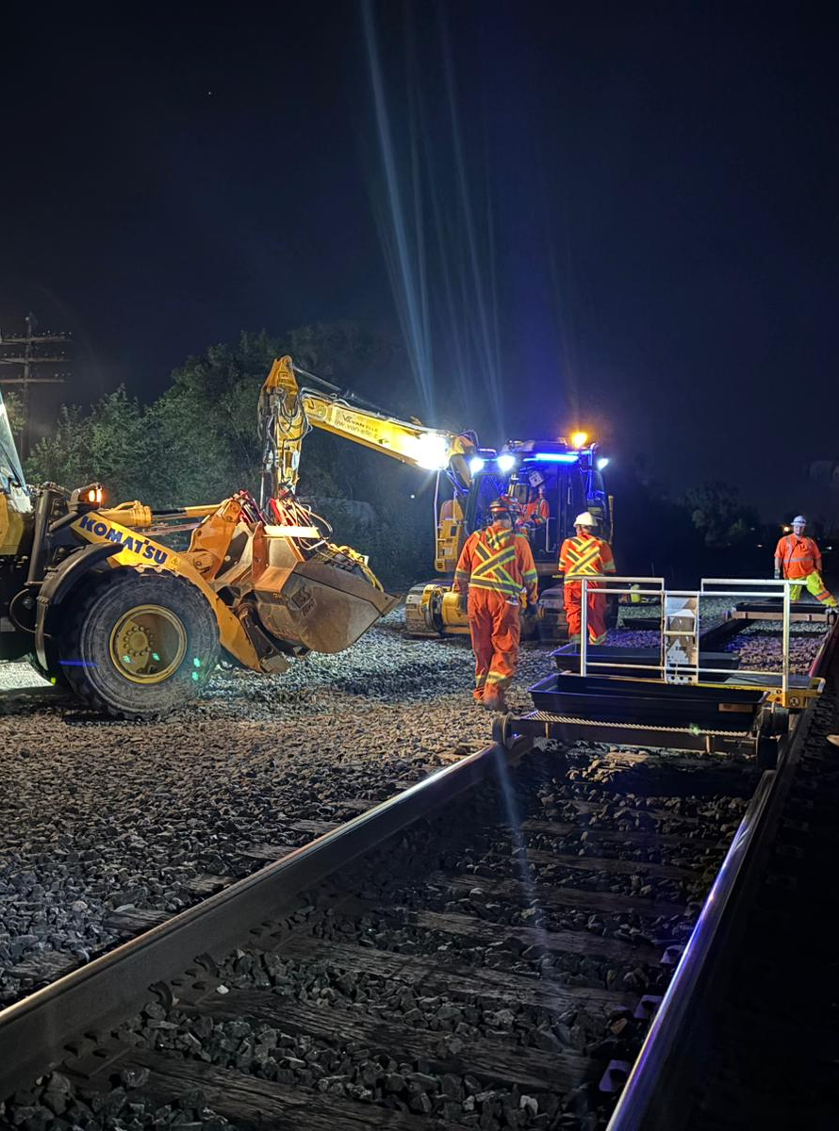
Updates will be communicated to the community via:
Mail drops of notices to residents
Bi-weekly Toronto West E-Newsletter
Project website (metrolinx.com/stclairoldweston)
Monthly Construction Liaison Committee (CLC) Meeting
Virtual and in-person public meetings
Community pop-ups
Toronto West phone number:
  416-202-6911
Toronto West email:
  TorontoWest@metrolinx.com
X: @GOExpansion
Metrolinx Engage
Cette présentation est disponible en français sur demande. Si vous êtes intéressé, veuillez envoyer un courriel à TorontoWest@metrolinx.com
29

Slide 30




Contact Metrolinx and Stay Connected
Metrolinx will keep the community informed by providing St. Clair-Old Weston Station updates and addressing questions and concerns effectively, and quickly.
Connect With Us:
Toronto West Community Engagement Team
TorontoWest@metrolinx.com 416-202-6911
E-newsletter: Metrolinx.com/subscribe
Scan the QR code for Metrolinx e-newsletter subscription
Follow us on social media:
@GOExpansion
This presentation is available in French upon request.
If you are interested, please email TorontoWest@metrolinx.com
Cette présentation est disponible en français sur demande.
Si vous êtes intéressé(e), veuillez envoyer un courriel à TorontoWest@metrolinx.com

