Slide 1

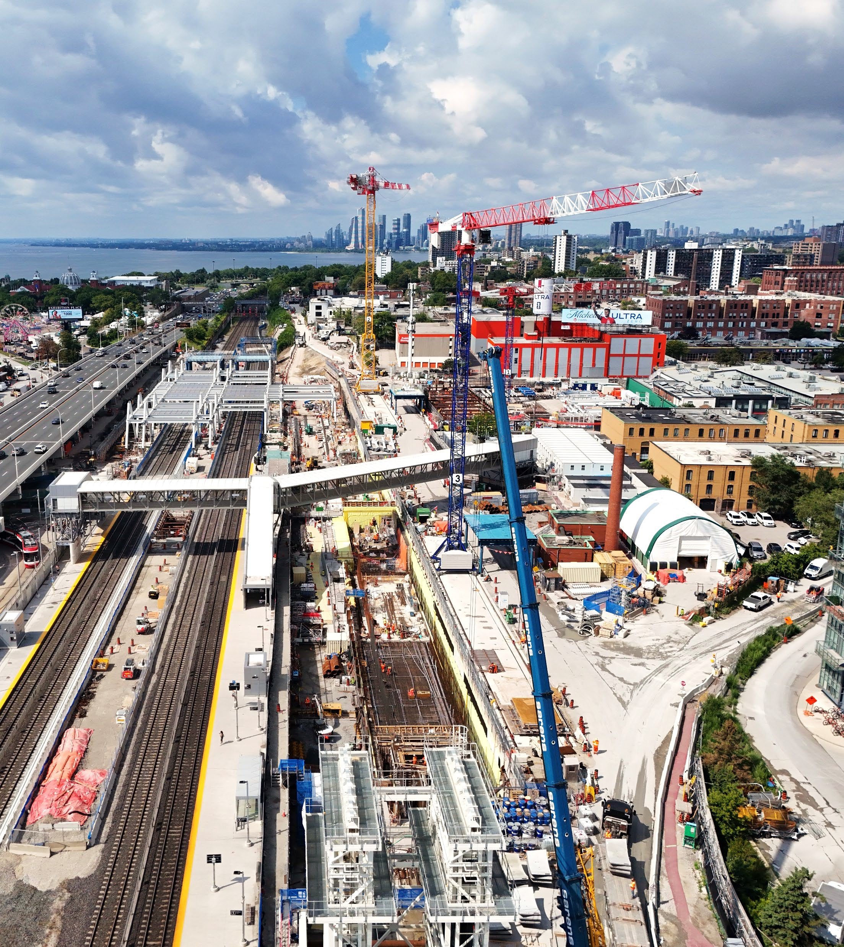

Ontario Line
LOOKING WEST TO THE EXHIBITION SITE (August 2026)
Exhibition Construction Liaison Committee
September 23, 2026

Slide 2
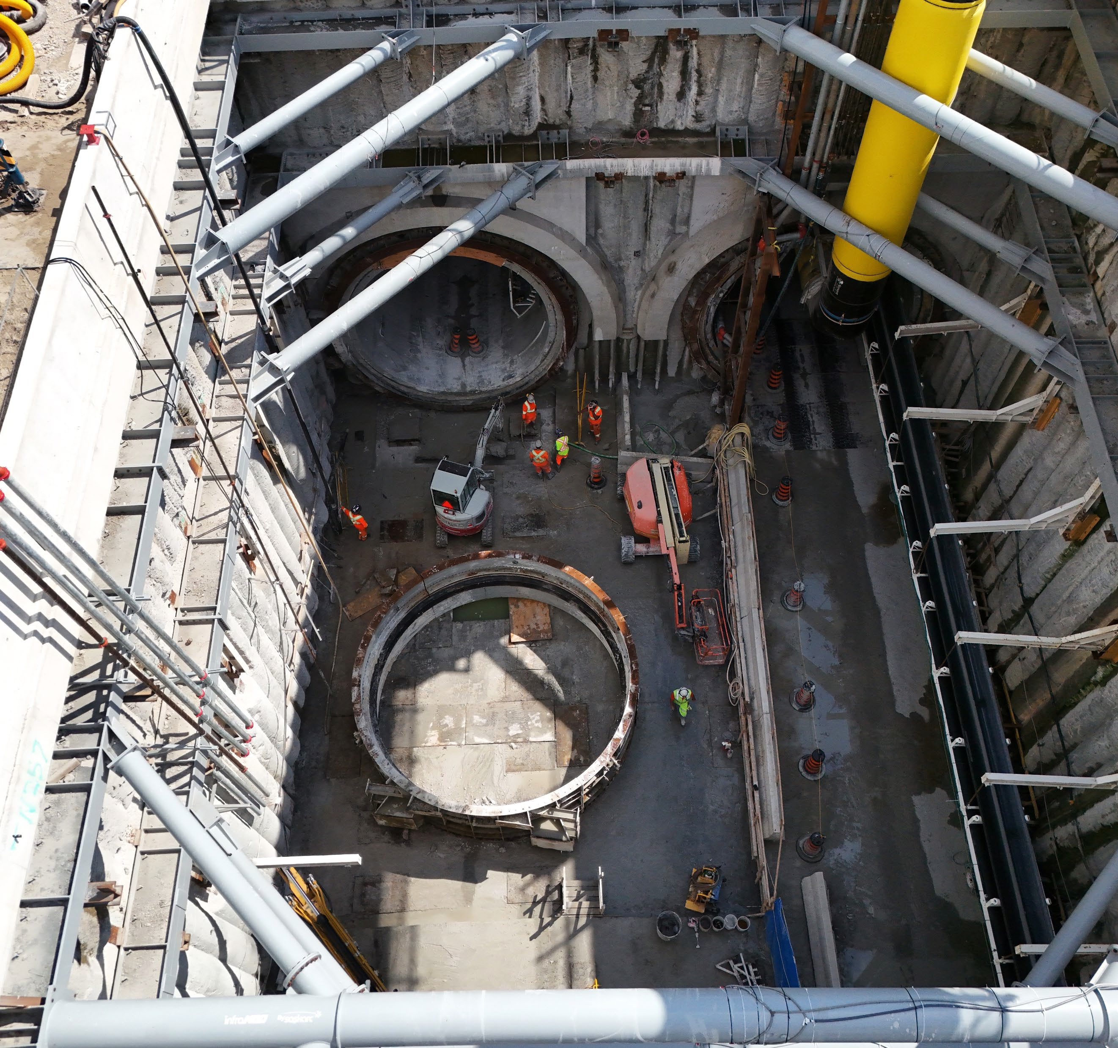

A LOOK AT THE SEAL CAN REMOVAL IN THE PORTAL (August 2026)
Agenda
Welcome (5 minutes)
Land Acknowledgement
Safety Moment
Conversation (30 minutes)
Truck & Dust Management
Construction Update
Q/A and Discussion (25 minutes)

Slide 3
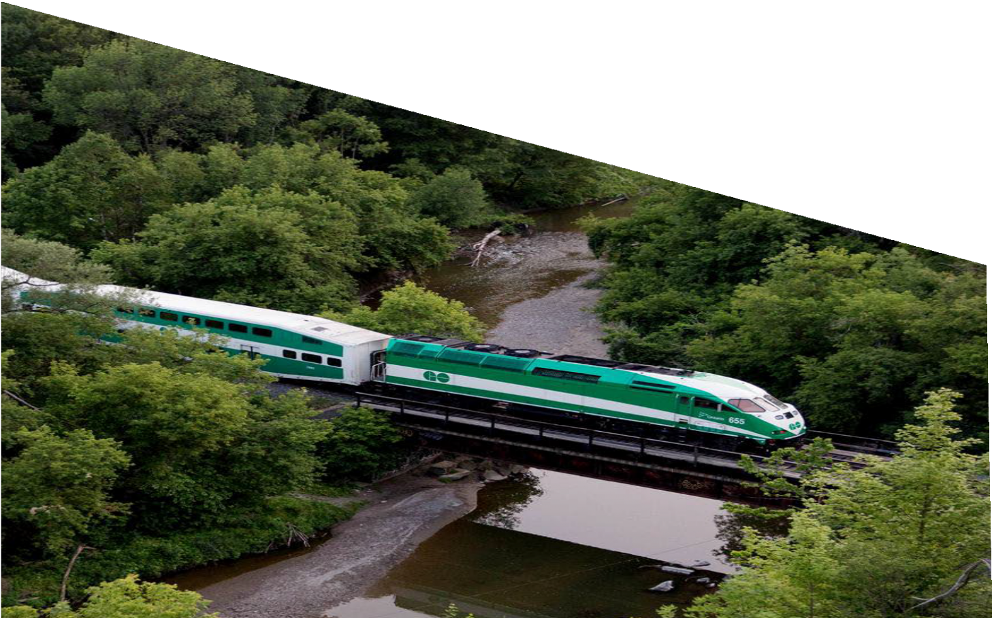
LAND ACKNOWLEDGEMENT
Metrolinx acknowledges that we connect communities by building and operating transit within the traditional lands of the Anishinaabe, the Haudenosaunee and the Wendat peoples, for whom these lands continue to have great importance.
Treaties between First Nations and governments cover these lands, and the promises contained in these Treaties remain relevant to this day.
Metrolinx and its employees are committed to understanding the history of these lands and the continued impacts of colonization and take responsibility for actions to advance reconciliation.
Metrolinx will continue to seek the knowledge, expertise and experience of Indigenous partners and commits to doing business in a manner that is built on a foundation of trust, respect, and collaboration.

Slide 4

SAFETY MOMENT – BACK TO SCHOOL
Let’s all do our part to ensure everyone stays safe during the busy back-to-school season, especially in areas near ongoing construction.
Watch for Construction Vehicles: Be aware of activity near construction zones, especially during school drop-off and pick-up times. Large vehicles may have blind spots, so maintain a safe distance.
Obey Traffic Signs and Signals: Follow all posted signs and signals in and around construction zones, especially in school zones. Reduced speed limits and temporary detours are in place to keep everyone safe
Use Designated Crosswalks: Teach children to use designated crosswalks and avoid shortcuts through construction areas. Construction sites can have hidden hazards.
Stay Alert: Avoid distractions like phones while driving or walking near construction sites. Be especially cautious around areas where children are present.
Plan Your Route: Allow extra time for your commute and consider alternate routes to avoid construction zones during peak school hours.
Ontario Line
4

Slide 5


Slide 6
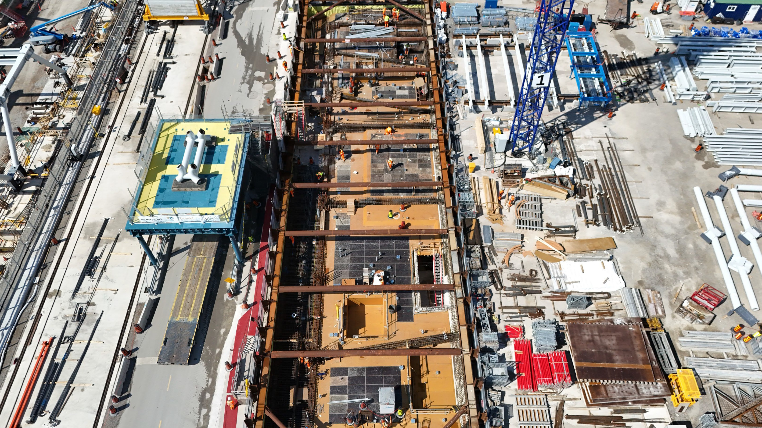
Exhibition Station Construction Update

Slide 7
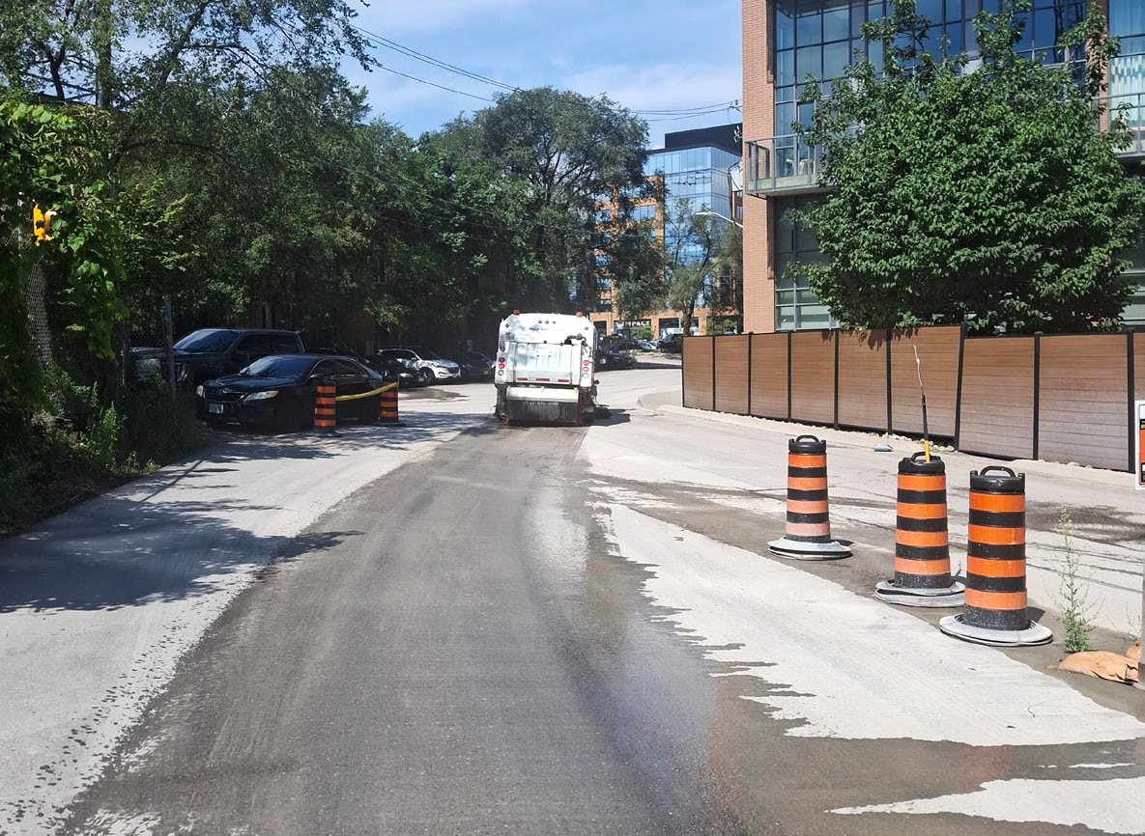
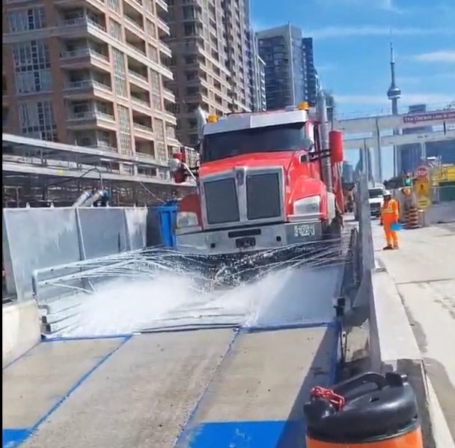
TRUCK & DUST MANAGEMENT IN LIBERTY VILLAGE
Truck Management:
Example of street sweeper
Tunnelling has increased truck activity and introduced additional trucking vendors.
Vendors receive daily reminders on approved routes, staging, idling requirements and route handouts are provided directly to drivers.
Crew members are periodically stationed around King Street West and site gates to check in drivers and reinforce requirements.
Additional signage has been installed throughout the neighbourhood to identify approved routes.
Additional Dust Management:
Street sweepers are deployed along the haul routes using wet sweeping methods.
Low pressure watering of the paved internal haul road and haul route to further limit dust leaving the site.
A wheel-washing system is in operation to clean muck hauling trucks before they exit.
Example of wheel washer
Ontario Line
7

Slide 8
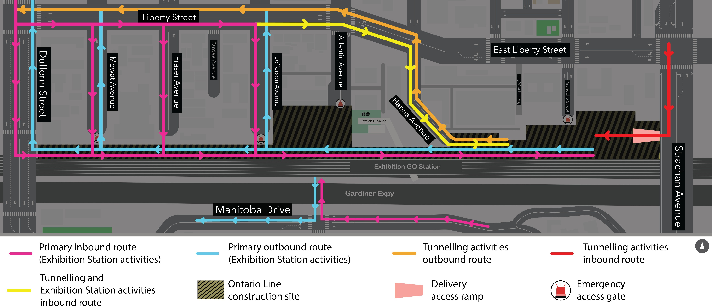
EXHIBITION STATION TRUCK ROUTE PLAN
Metrolinx additional truck routes available. Occasional oversized deliveries may occur through Hanna Avenue. If the designated gate is unavailable, trucks may use an alternate approved gate as directed. Haul routes subject to change.
Ontario Line
8

Slide 9
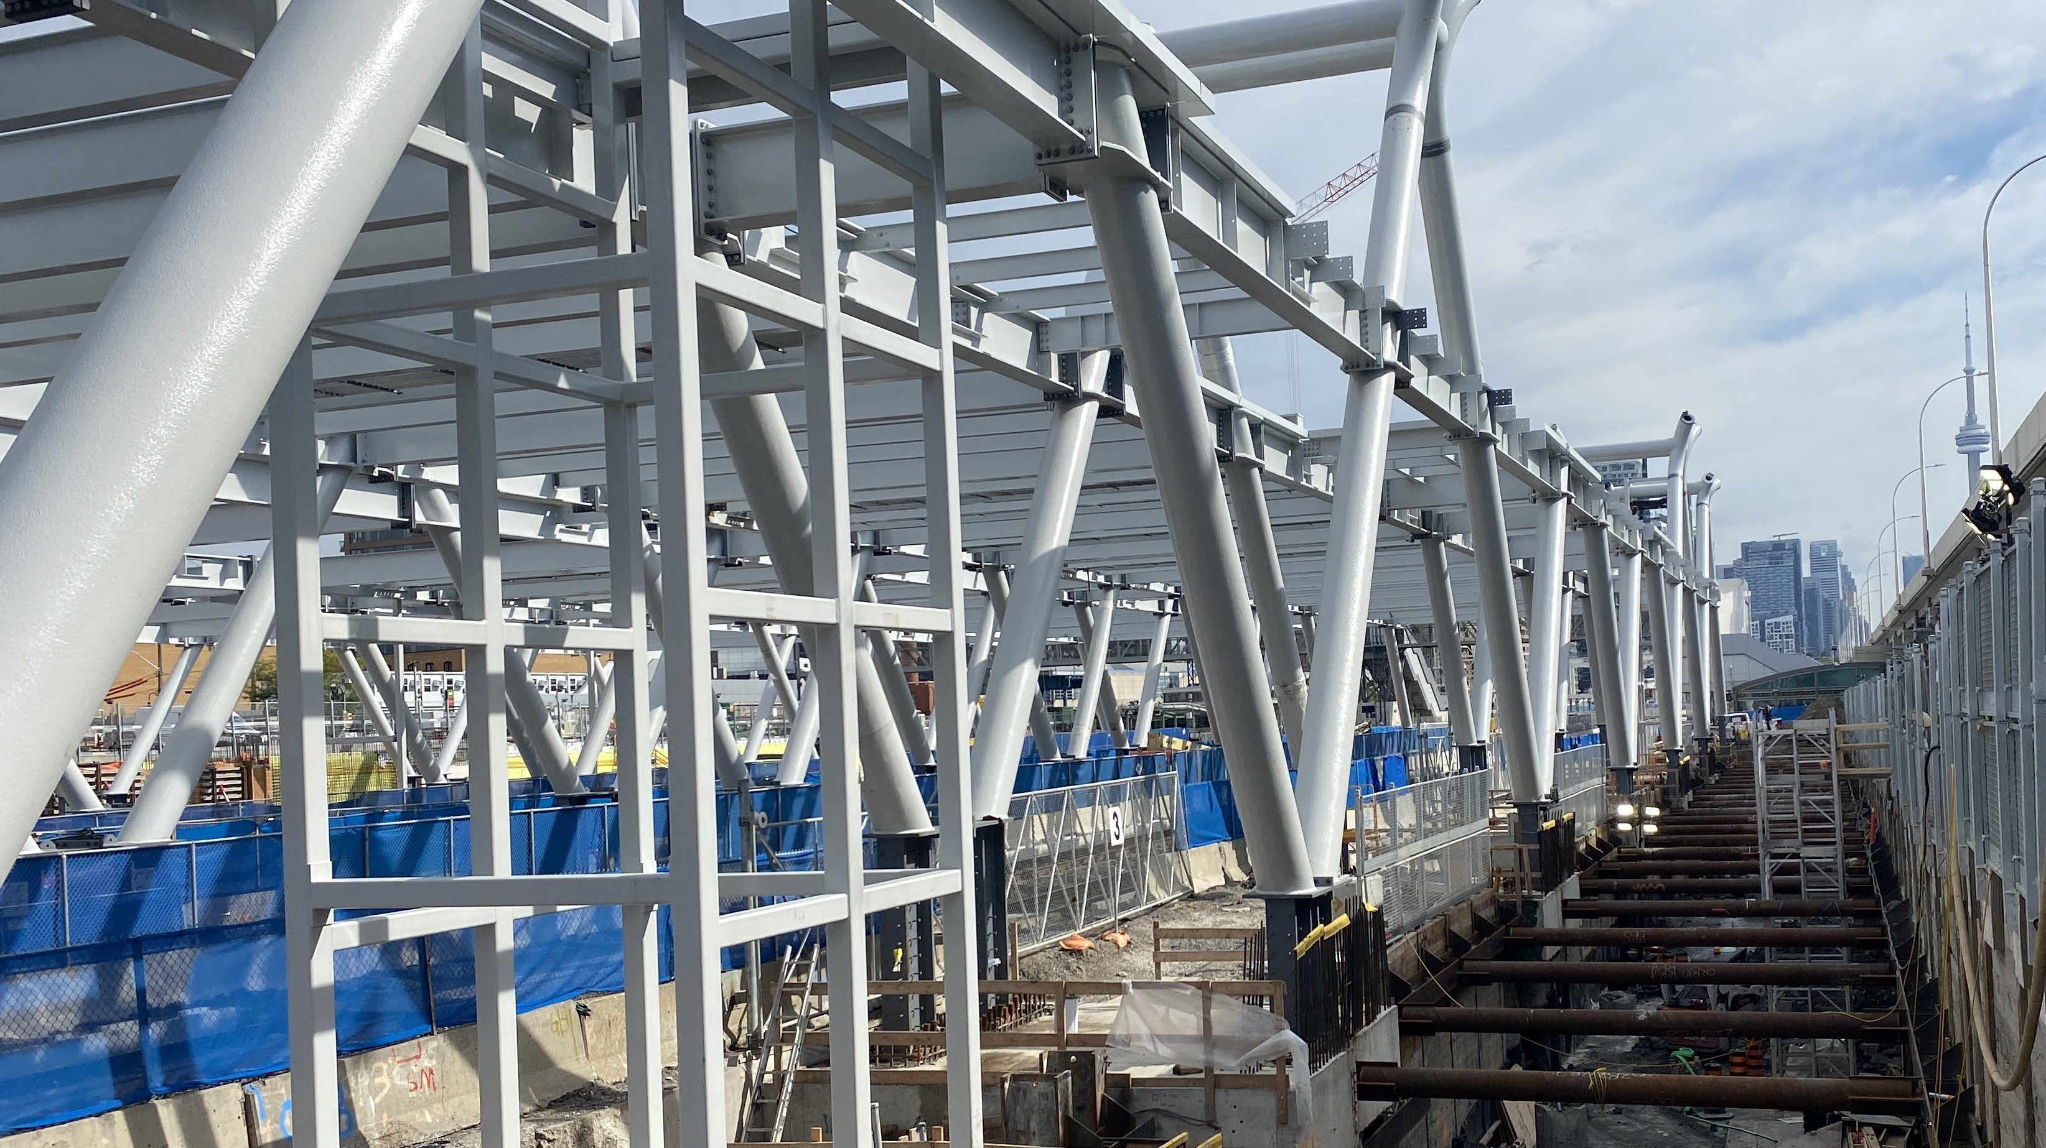
Discussion

Slide 10
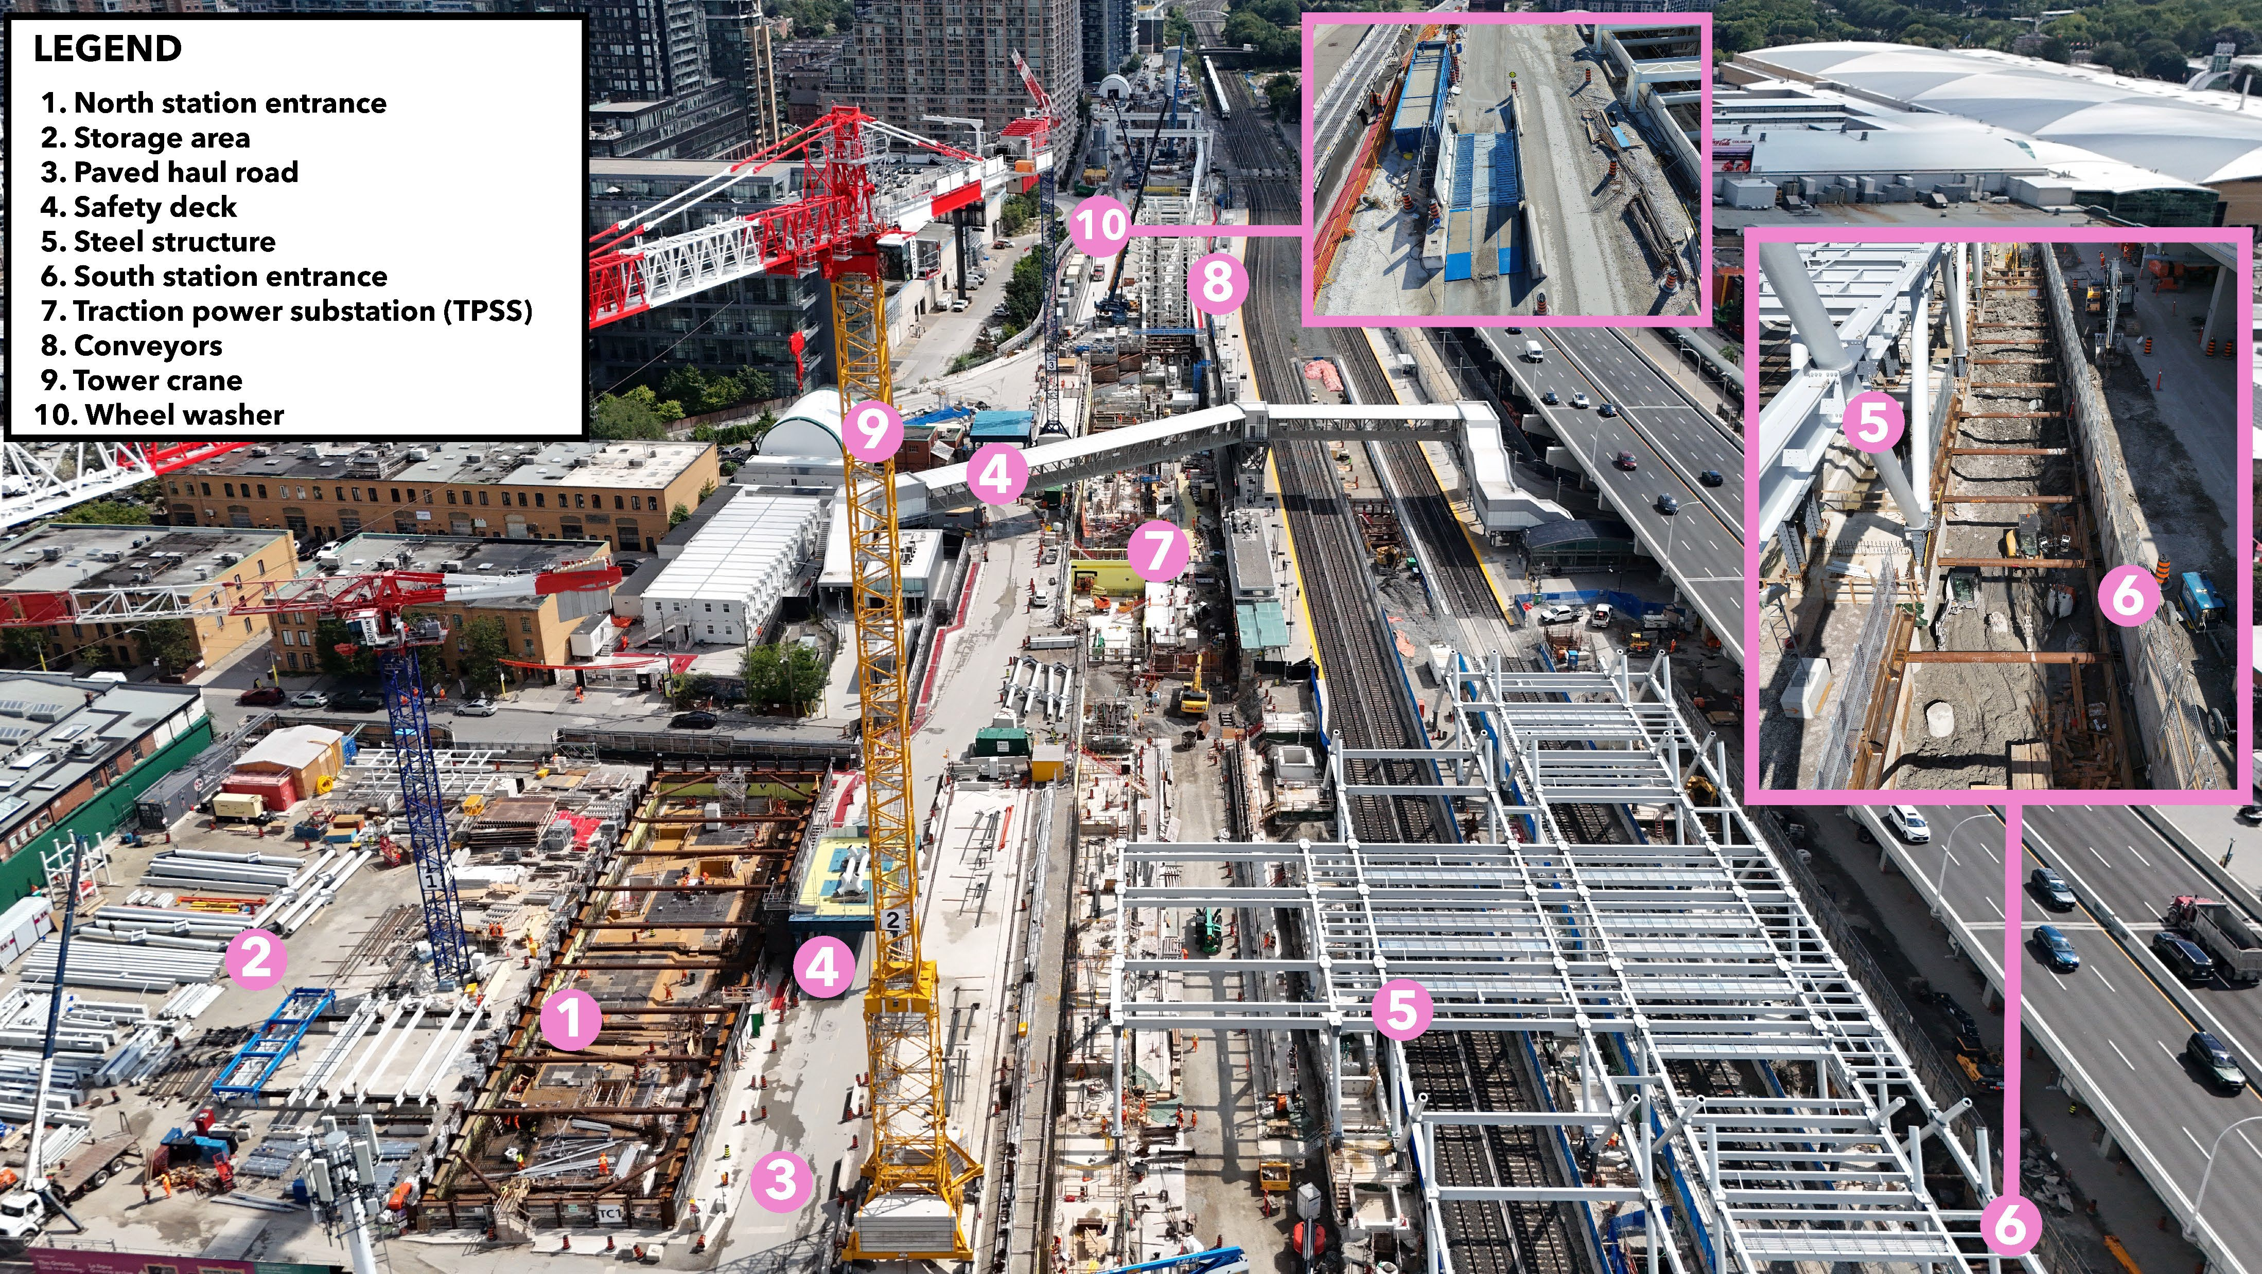

Atlantic Avenue
LOOKING EAST (August 2026)
10

Slide 11
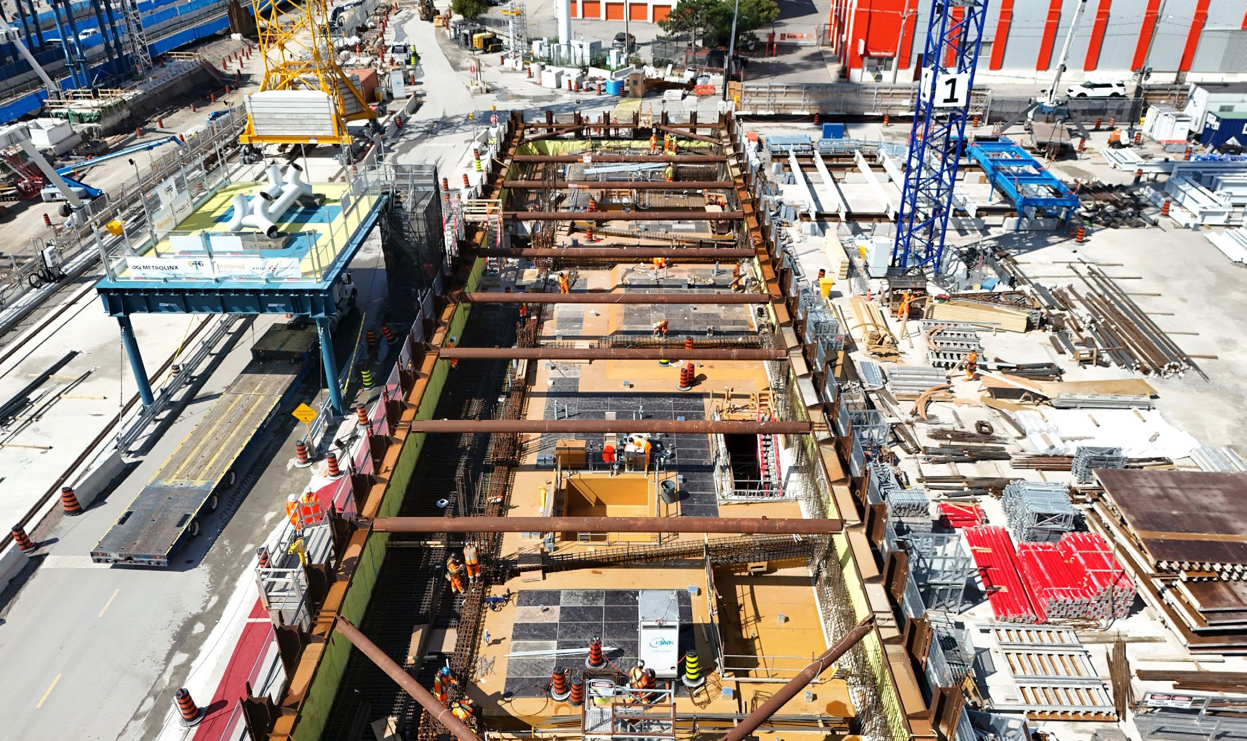

CURRENT WORK: FUTURE EXHIBITION STATION WEST SIDE
Platforms works:
Excavation, rebar, waterproofing, concrete, electrical and plumbing.
North entrance & TPSS:
Foundation and structural work is underway including rebar, waterproofing, and concrete.
Main Station:
Structural steel installations for the future concourse.
Safety deck
What’s next:
South entrance shaft excavation is ongoing with completion of the first level of struts.
Above ground works at NME and TPSS are underway.
Watermain work from Dufferin Avenue to Jefferson Avenue, including water shutdowns starting late October.
Last struts to be removed
A view of the future north station entrance (August 2026)
Ontario Line
11

Slide 12
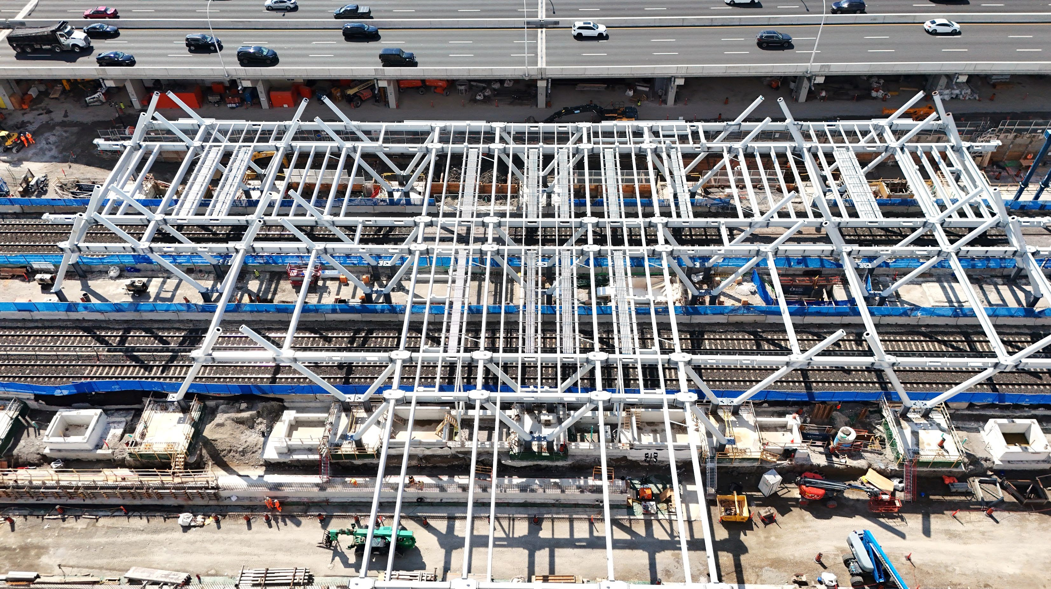

A VIEW OF THE STRUCTURAL STEEL INSTALLATION (August 2026)

Slide 13
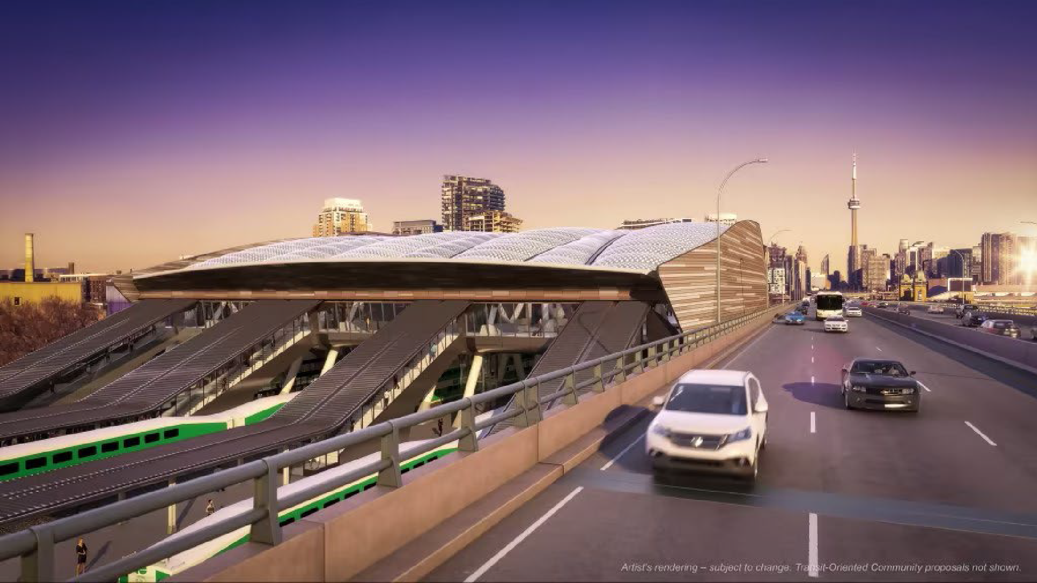
ARTISTS RENDERING OF EXHIBITION STATION CONCOURSE
EXHIBITION OPEN HOUSE – FEBRUARY 2024

Slide 14
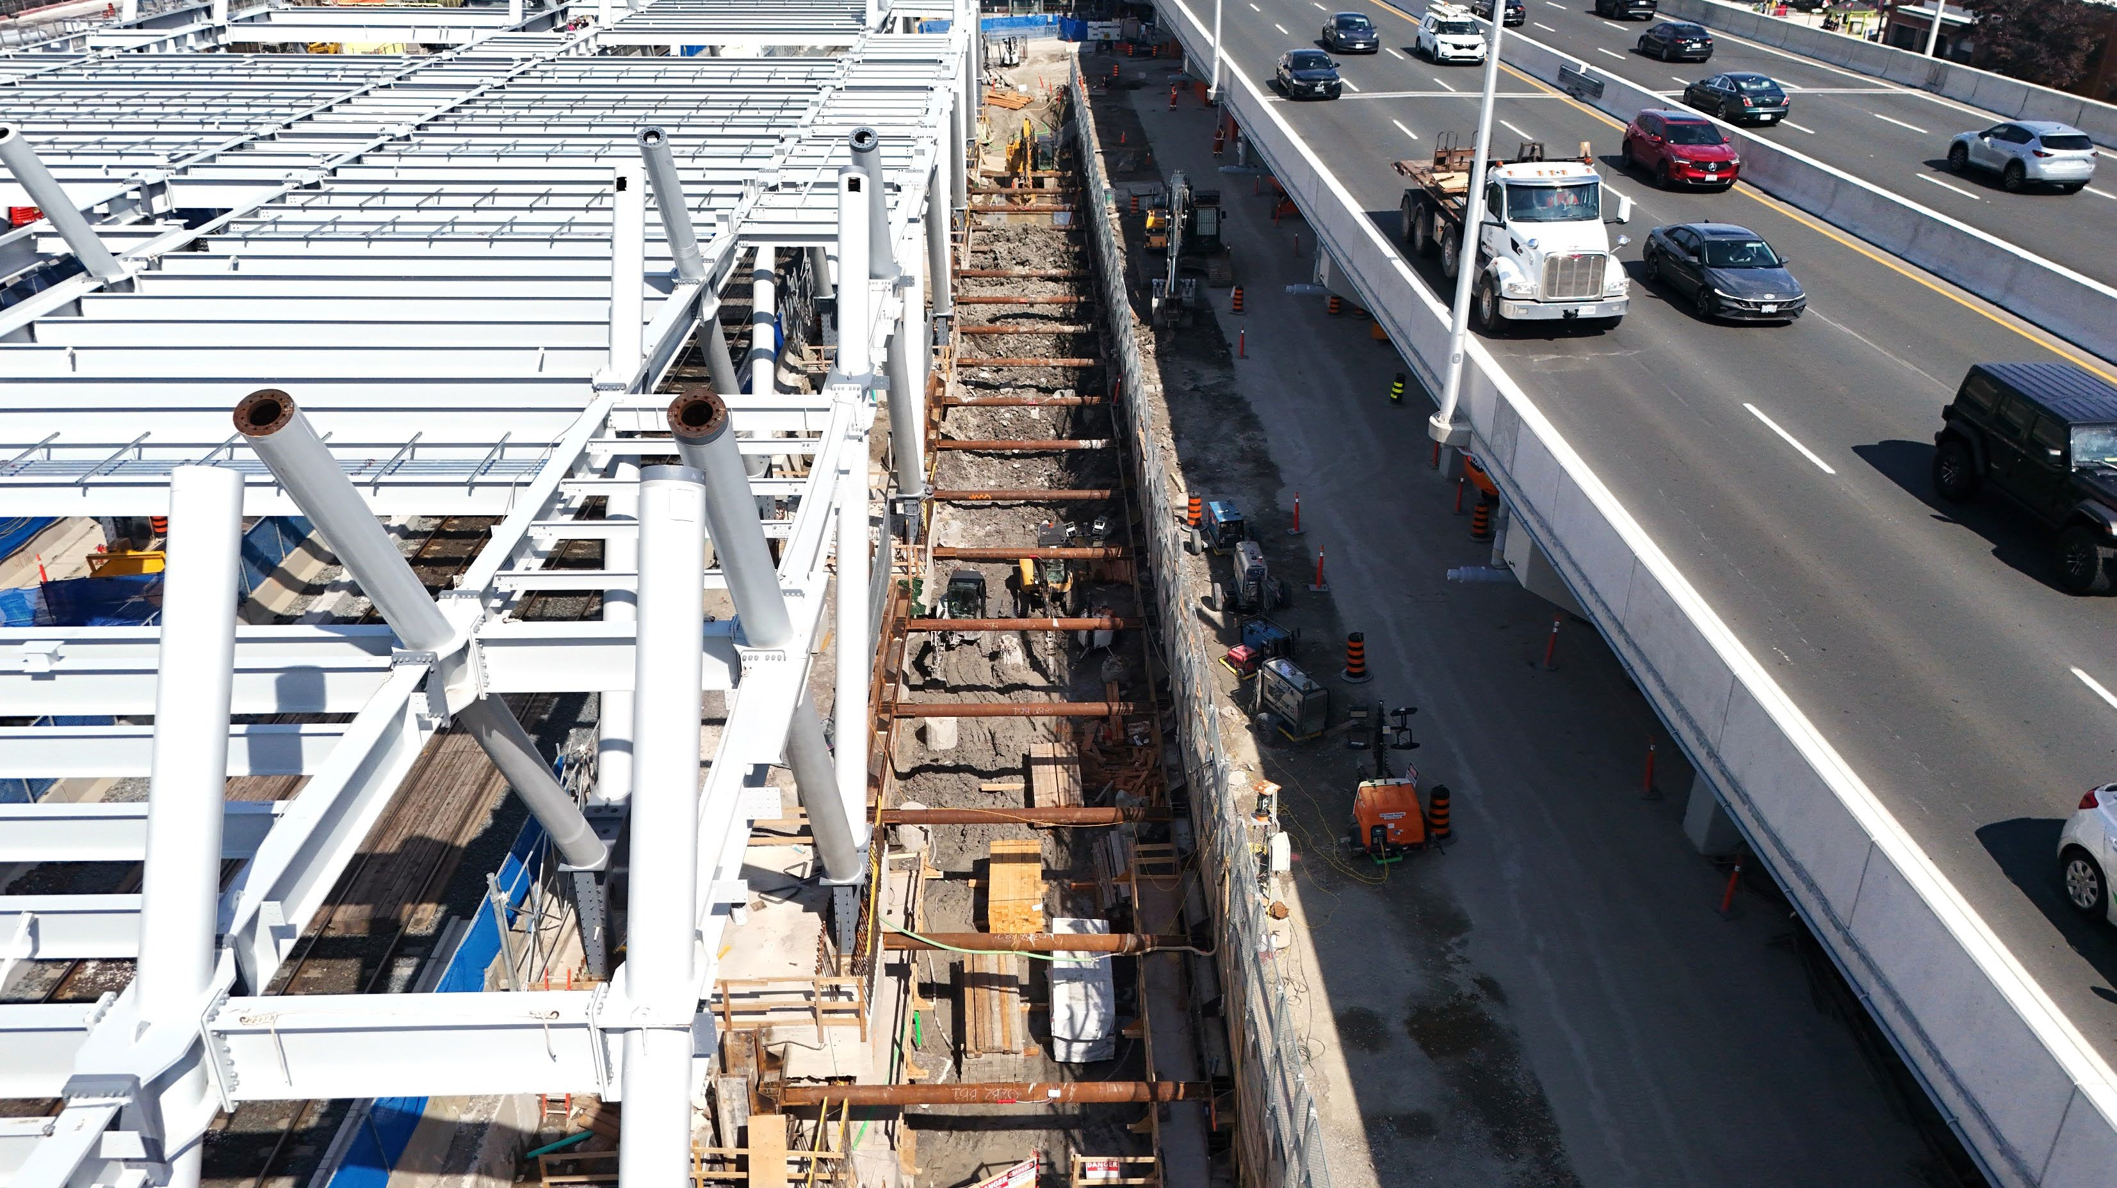

A VIEW OF THE SOUTH ENTRANCE STRUT INSTALLATION (August 2026)

Slide 15
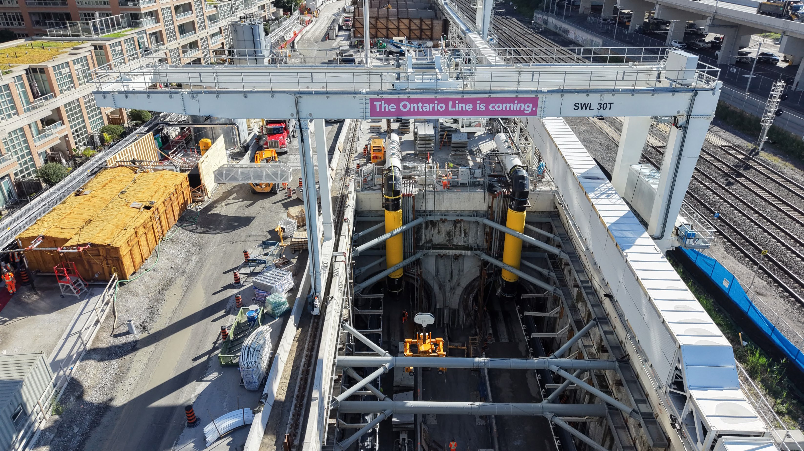
Tunnelling

Slide 16
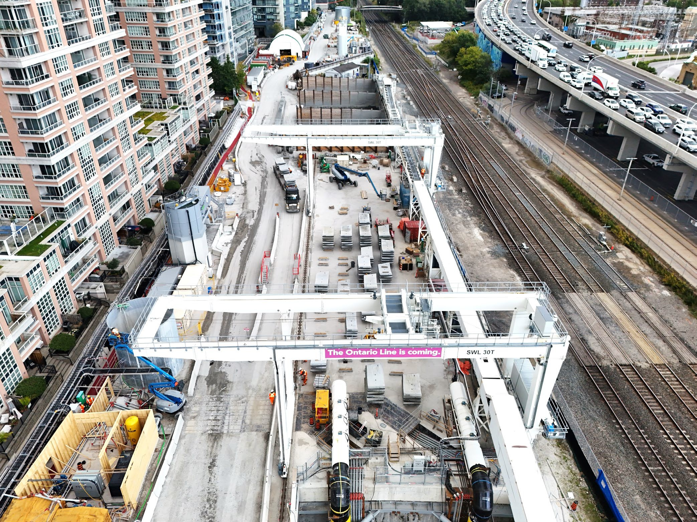



CURRENT WORK: FUTURE EXHIBITION STATION EAST SIDE
Tunnelling:
TBM 1 & TBM 2 have both left the portal and are making their way across the alignment.
TBM Support Operations:
Two gantry cranes have been installed to support the movement of the tunnel lining segments.
Tunnel lining segment storage area is complete, east of the portal.
What’s next:
Construction activity will increase as tunnelling continues, including additional truck movements.
Muck pit roof installation will begin this fall.
A view of the gantry crane and tunnel segment storage (September 2026)
Ontario Line
16

Slide 17
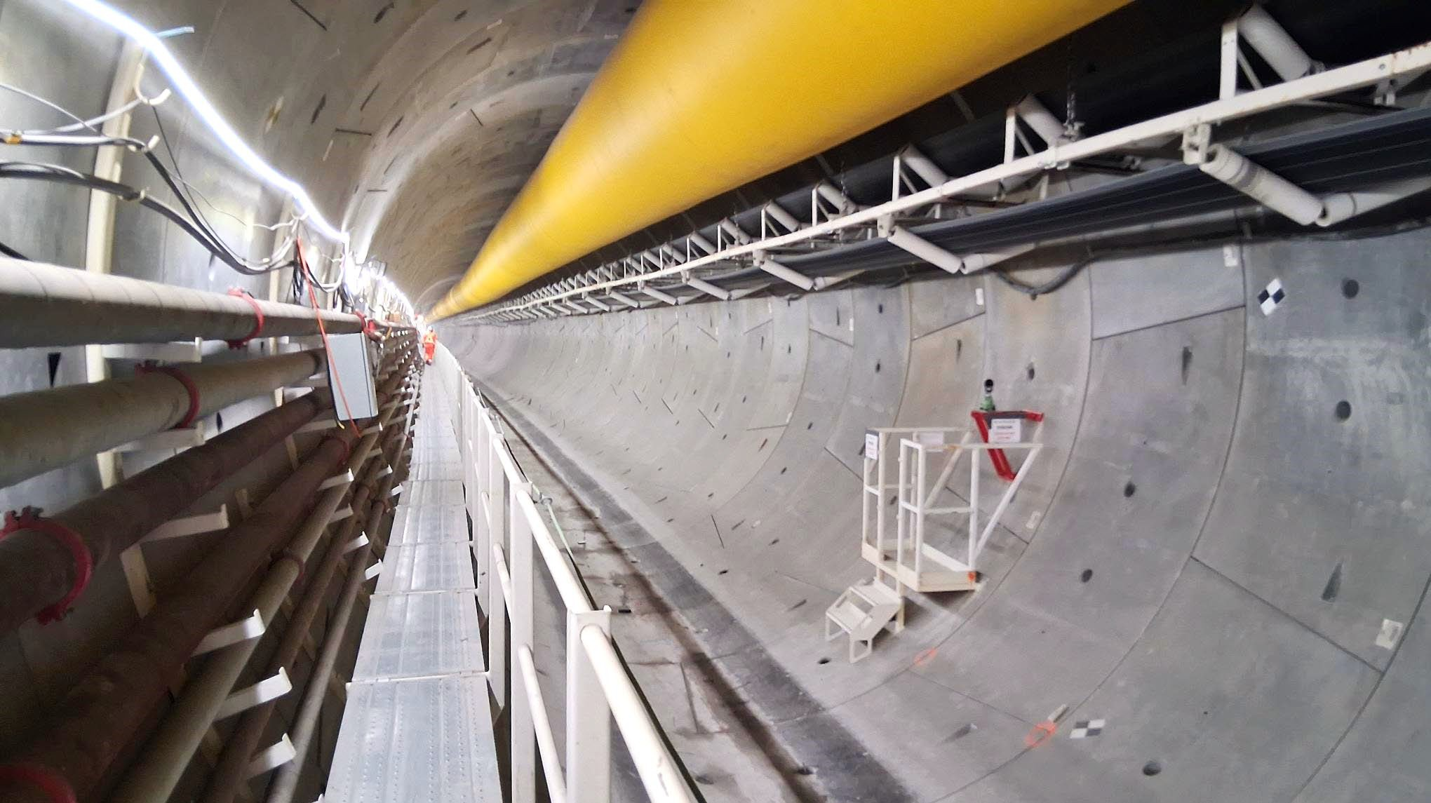
A VIEW FROM INSIDE THE TUNNEL (August 2026)

Slide 18
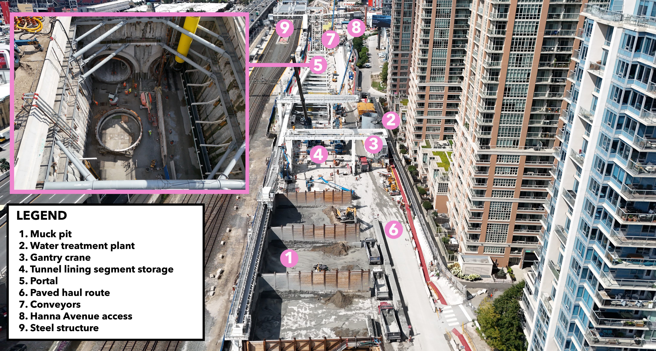

85 East Liberty Street
75 East Liberty Street
65 East Liberty Street
59 East Liberty Street
Pirandello Street
LOOKING WEST (August 2026)

Slide 19
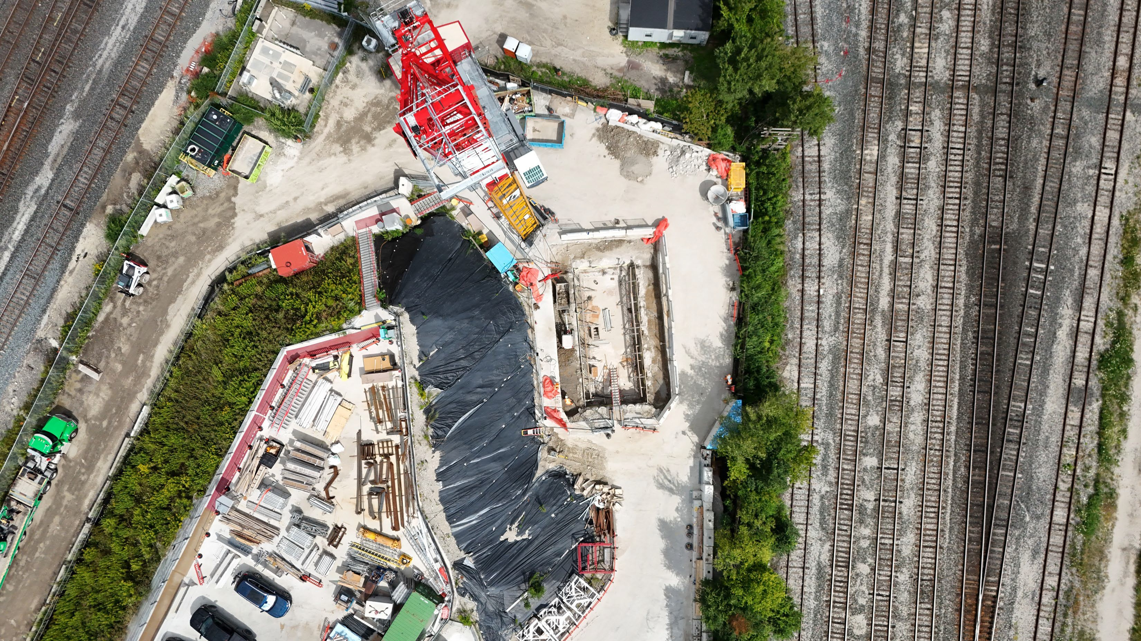
Ordnance Park EEB Construction Update

Slide 20
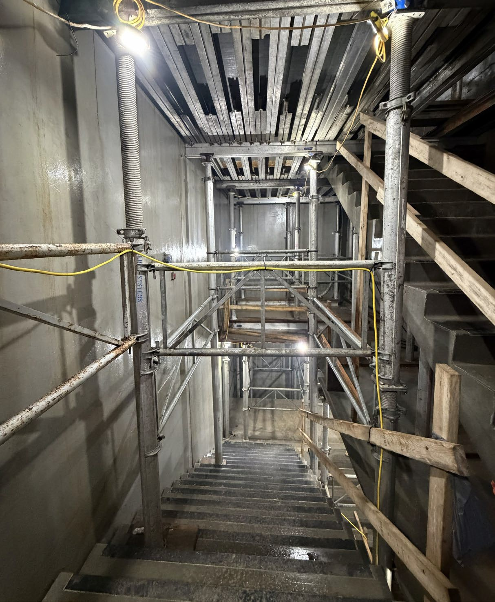
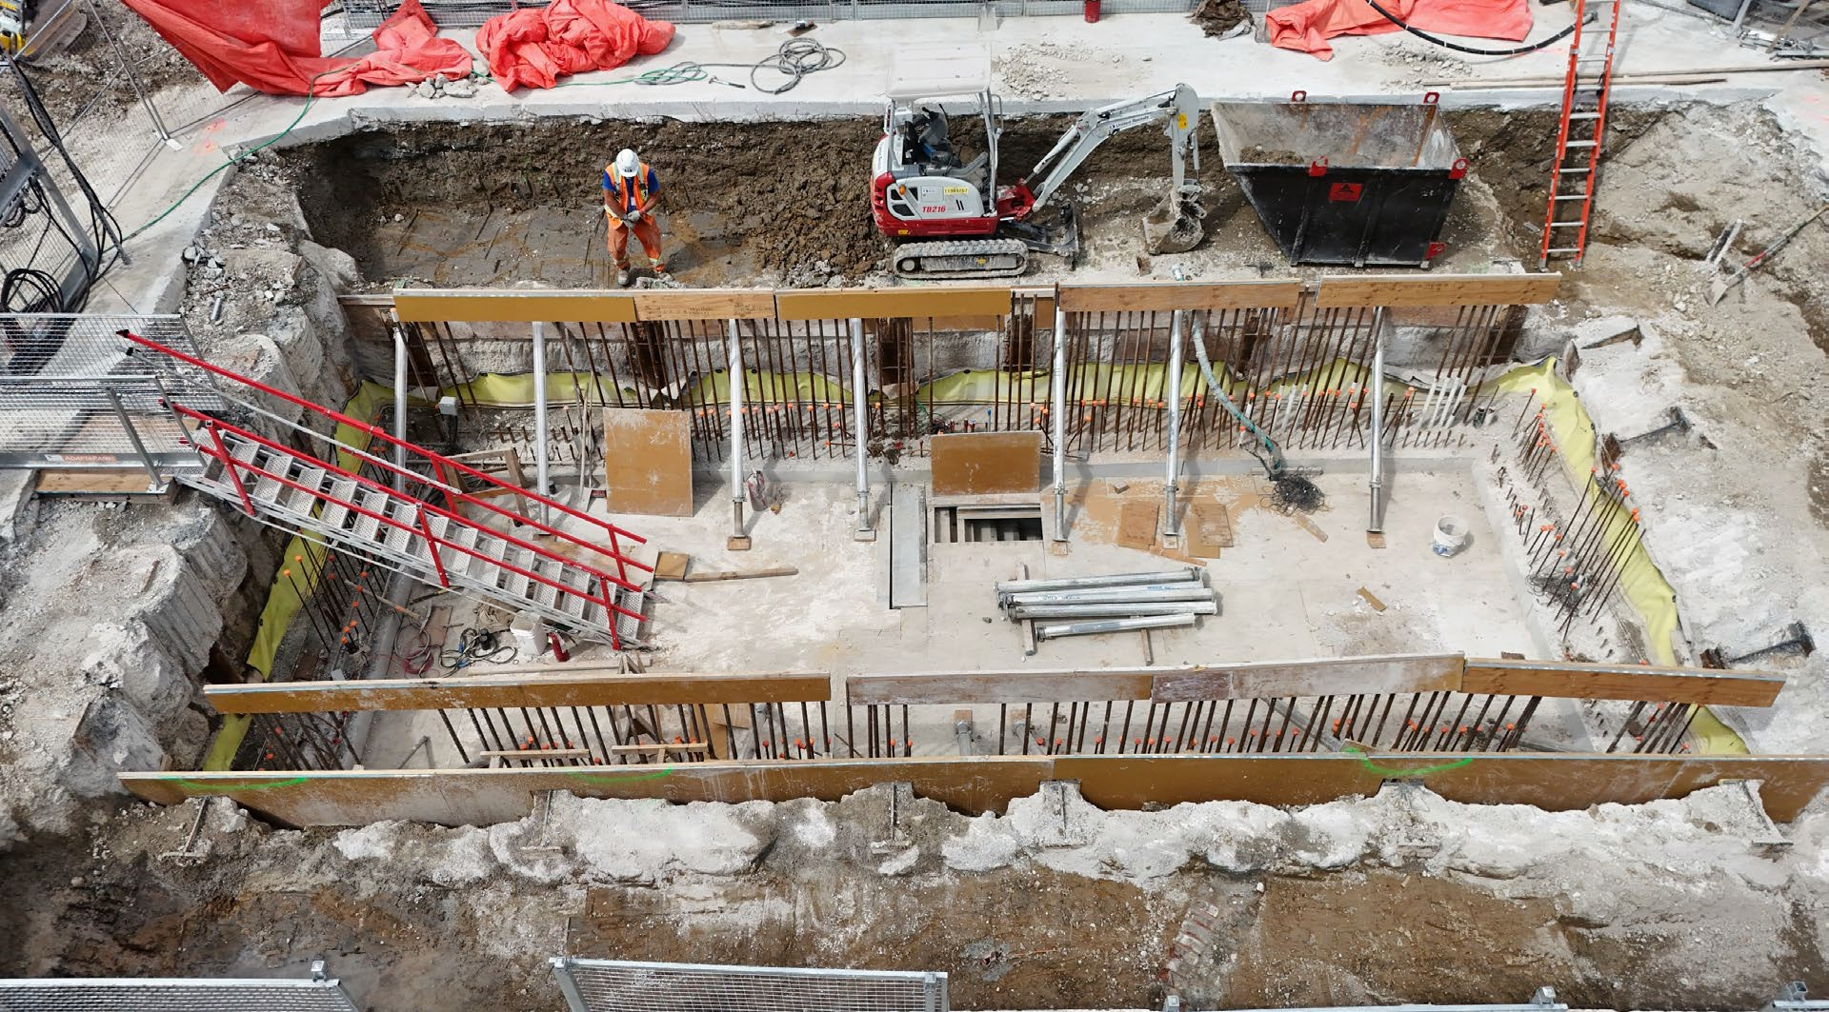


CURRENT WORK: FUTURE ORDNANCE PARK EMERGENCY EXIT BUILDING PROGRESS
Crews are in the final stages of permanent works at Ordnance Triangle Park for the future Ontario Line Emergency Exit Building (EEB), including rebar, formwork, and concrete pours.
Work will shift above ground this fall, with structural framework installation, tower crane removal, and retaining wall construction.
Street level
Rebar
Precast stairs
A look at the permanent works inside the shaft (August 2026)
A look at the permanent works before above ground construction (August 2026)
Ontario Line
20

Slide 21
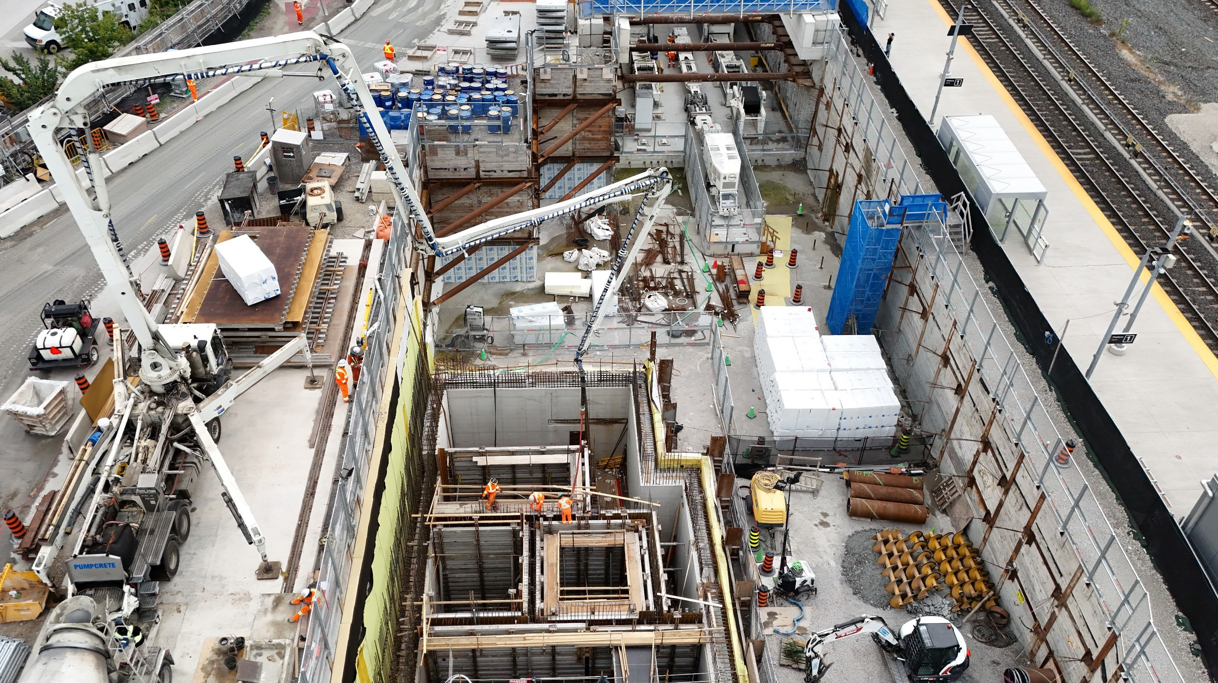
Questions & Answers

Slide 22
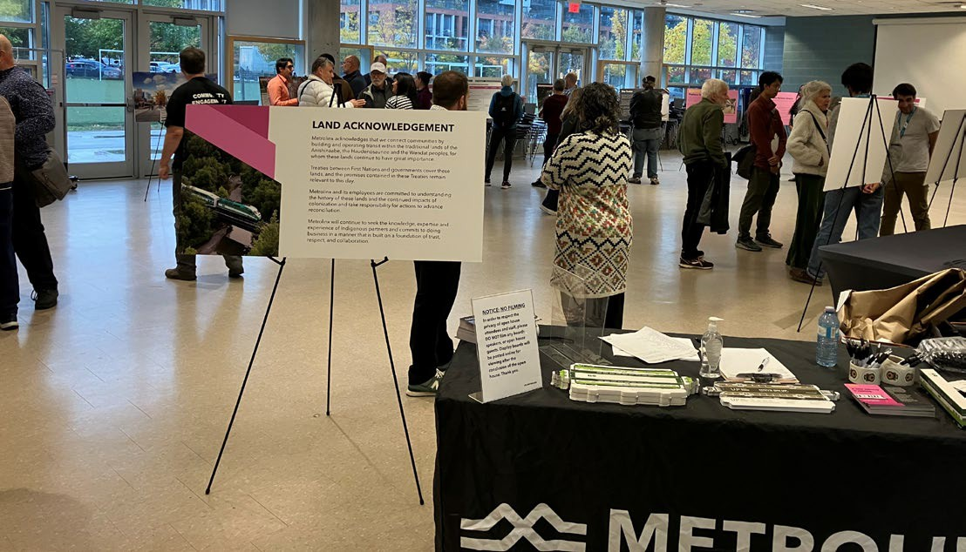
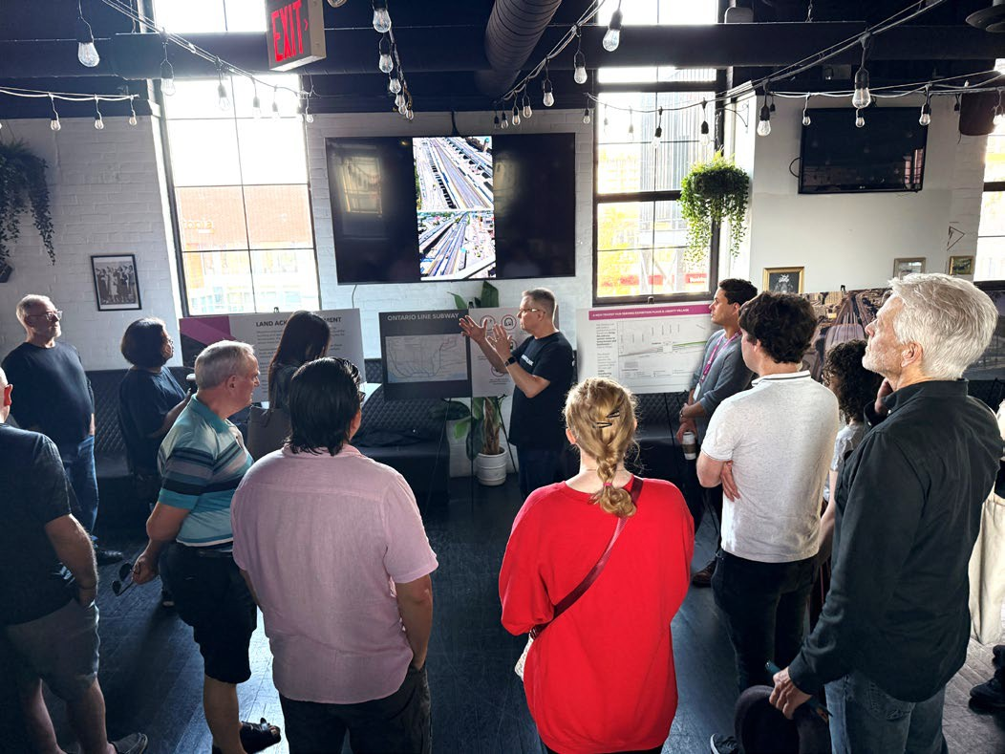
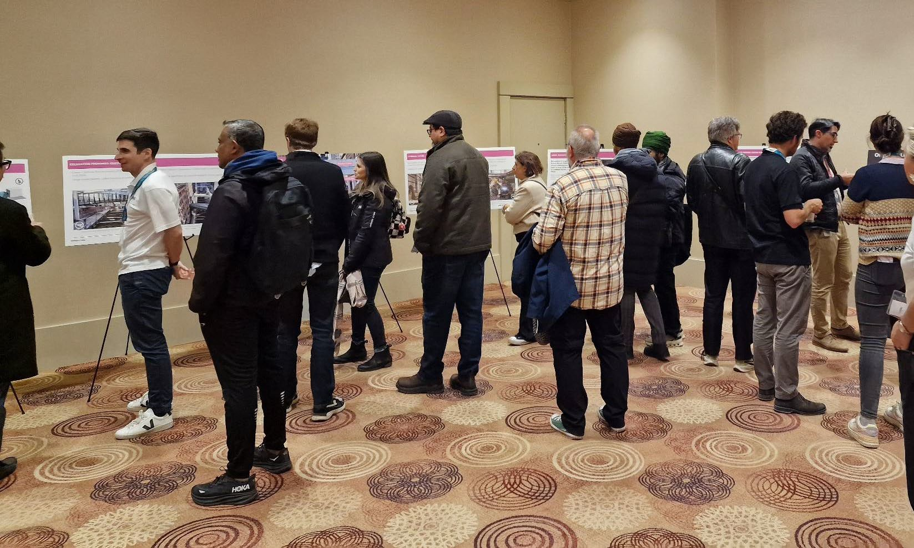
ONTARIO LINE OPEN HOUSE COMING THIS FALL
Exhibition & Ordnance Park EEB Open House
Location: Black Sheep
(Brazen Head Pub, 3rd Floor) Date: Saturday, November 7th, 2026 Time: 9:30 a.m. to 11:30 a.m.
Connect with the team delivering the Ontario Line at Exhibition.
Moss Park & Distillery District Open House (Oct. 2025)
Learn more about tunnelling, future station buildings, new trains and the work taking shape in your neighbourhood.
Exhibition Open House (Oct. 2025)
Osgoode & Queen Open House (Nov. 2025)
Ontario Line
22

Slide 23
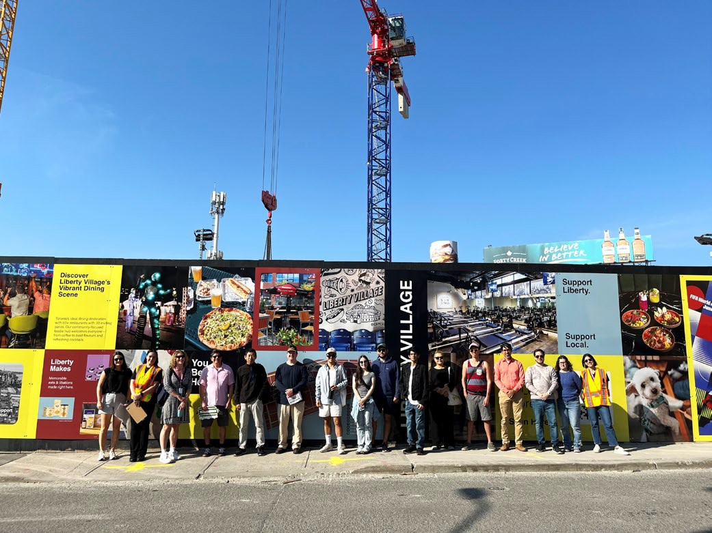
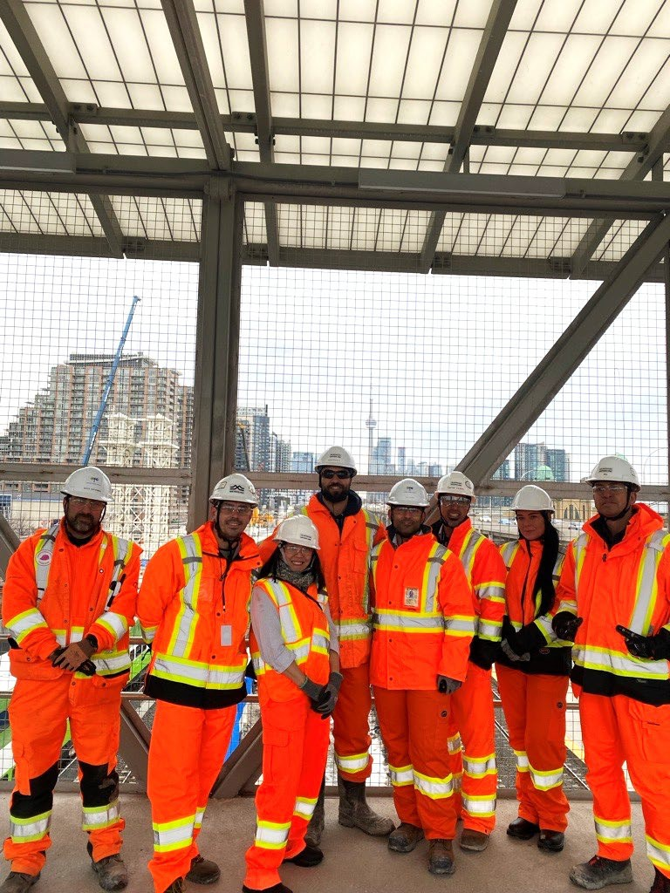
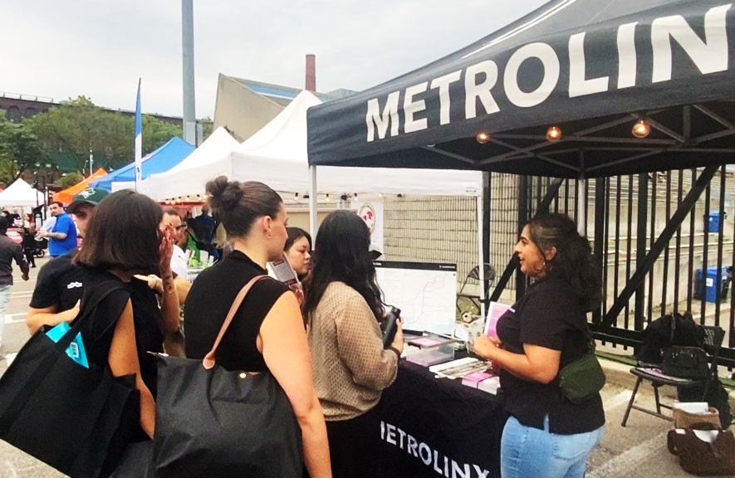
KEEPING YOU INFORMED
Metrolinx will keep the community, residents and businesses informed by providing project updates, seeking input and feedback to address concerns or questions.
Connect with us: OntarioLine@metrolinx.com Telephone 24/7 @ 416-202-5100
New interactive map:
metrolinx.com/map
Ontario Line
23

Slide 24

24

Slide 25
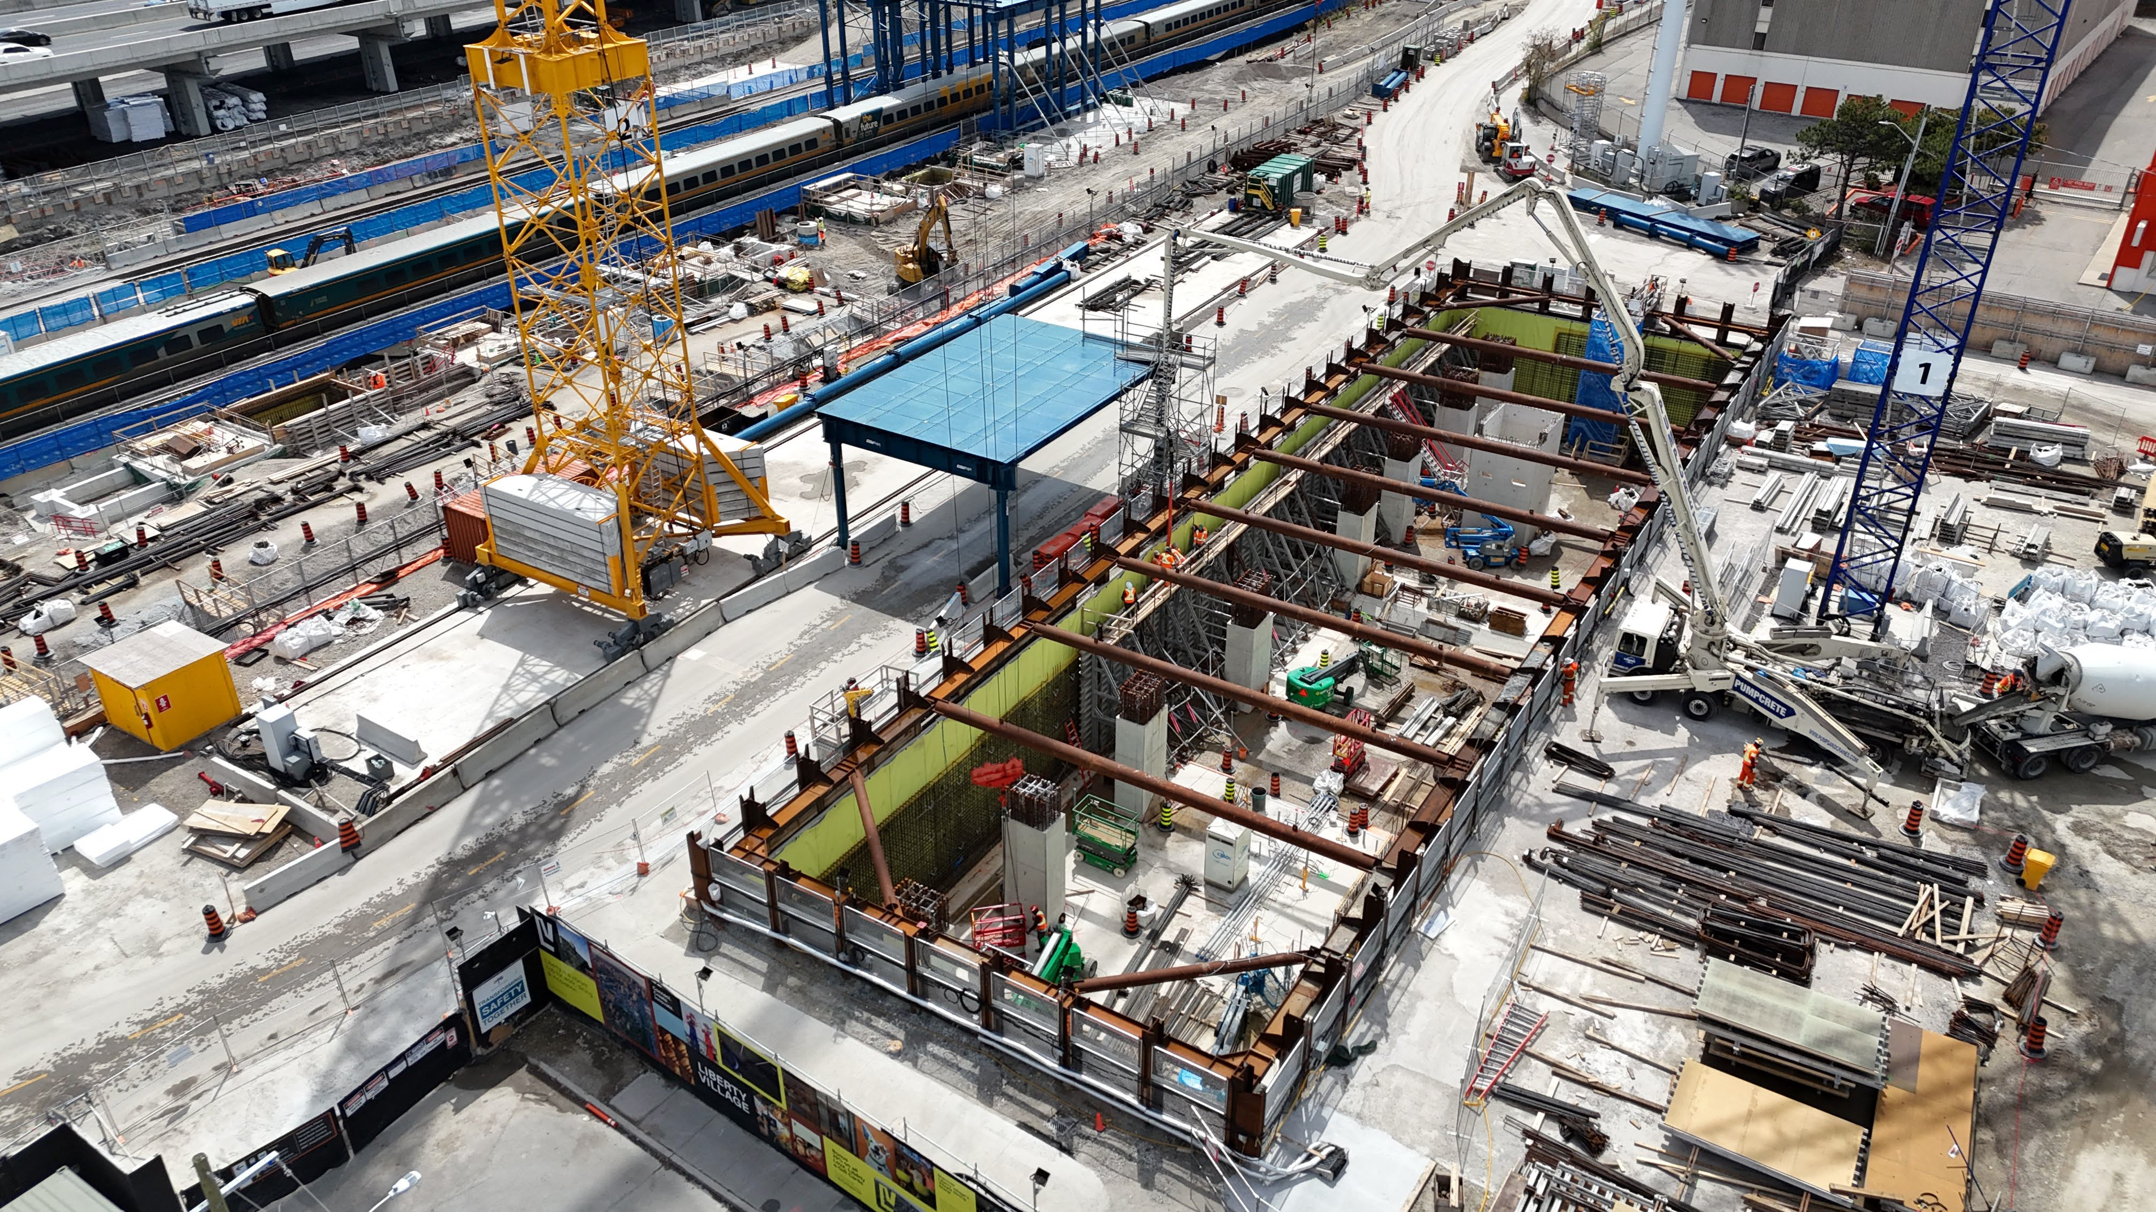
Upcoming Work

Slide 26
LOOK-AHEAD SCHEDULE
# | Activity | Expected Start | Location | Expected Duration Remaining | Impact | Hours of Work | Mitigations
1 | Structural steel | Ongoing | West side | Spring 2027 | Noise | Monday to Friday, 24 hours/day. Occasional weekends. | Dust mitigation includes, street sweeping, watering roads, hoarding fencing and misting during excavation. Noise, vibration and air quality monitoring. Traffic control (flaggers and planned routes and logistics) to minimize traffic disruptions.
2 | Permanent work (waterproofing, rebar, concrete works, foundation and structural works) | Ongoing | West side + South side | End of 2026 | Minor noise
4 | Tunnelling + TBM temporary support structures | Ongoing | East side | Up to 3 years (throughout tunnelling) | Vibration, noise, dust | Monday to Friday, 24 hours/day with maintenance on weekends. | Enclosed structures for noise, dust and vibration mitigations. Street sweeping, noise and air quality monitoring. Traffic control (flaggers and planned routes and logistics) to minimize traffic disruptions.
5 | Utility crossing | Ongoing | Throughout site | End of 2026 | Noise, vibration | Monday to Saturday, 7 a.m. to 5 p.m. and 7 p.m. to 5 a.m. | Dust mitigation includes, street sweeping, hoarding and fencing. Noise, vibration and air quality monitoring. Traffic control (flaggers and planned routes and logistics) to minimize traffic disruptions.
*Note: All dates are times are subject to change as construction planning progresses
Temporary additional hours will be required during planned construction taking place on the Lakeshore West line. During these periods, work will run 24 hours a day, including weekends in the south entrance, platforms and structural steel. Upcoming dates include:
Oct. 17-18
Oct. 24 –25
Dec. 5-6
Ontario Line
26

Slide 27
PROJECTED EXHIBITION HAULING SCHEDULE
DATES | Dufferin Street | Mowat Avenue | Jefferson Avenue | Strachan Avenue | Hanna Avenue | Fraser Avenue | Atlantic Avenue | Manitoba Drive
INBOUND (Peak number of trucks per day)
SEPT. 2026 | 8 | 6 | 5 | 114 |  | 2 | 5
OCT. 2026 | 7 | 4 | 4 | 138 |  | 2 | 5
NOV. 2026 | 7 | 4 | 4 | 153 |  | 2 | 5
OUTBOUND (Peak number of trucks per day)
SEPT. 2026 | 8 |  | 8 |  | 118 |  | 5
OCT. 2026 | 7 |  | 7 |  | 141 |  | 5
NOV. 2026 | 7 |  | 7 |  | 156 |  | 5
The presented figures reflect the highest daily average peak. Truck volumes vary daily depending on the type of activity. Average number of trucks are subject to change. Occasional oversized deliveries may occur through Hanna Avenue. If the designated gate is unavailable, trucks may use an alternate approved gate as directed. Haul routes subject to change and are directed by Metrolinx in accordance with the City.
Ontario Line
27

